Slide 1
Next-Generation Character Rendering Jorge Jimenez Javier von der Pahlen Technical Director Director of R&D Activision Blizzard Activision Blizzard

Slide 2
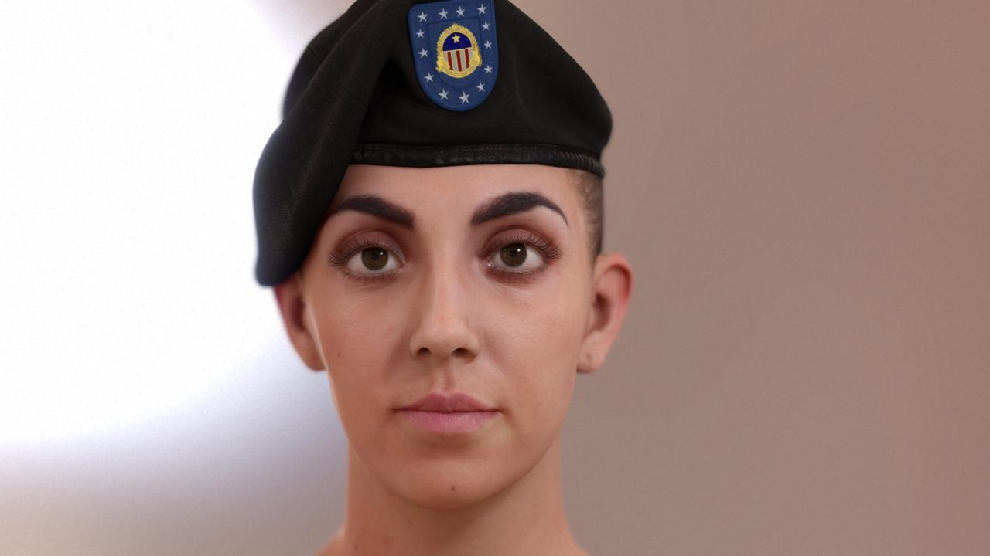
© Activision Blizzard
Notes:
Hi,
This presentation is all about the details, and how a collection of very small things can be crucial for bringing characters to life.
Something I learnt these past years working with faces is that each character rendering feature counts,
even if it doesn’t seem to make sense when used individually.

Slide 3

Disclaimer
Projectors don’t do justice to the details of our renderings
This presentation reflects R&D that ATVI is exploring
This content is for presentation purposes only and does not reflect actual design examples nor actual game assets
Full presentation with more details here:
http://www.iryoku.com/stare-into-the-future

Slide 4
Notice for Offline Reading
Slides are best viewed fullscreen, in order to appreciate all the details and subtleties
Don’t miss the speaker notes, most slides have them

Slide 5
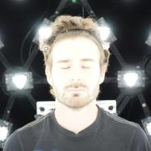
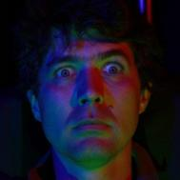




Jorge Jimenez
Graphics R&D
Javier von der Pahlen
Director of R&D
Etienne
Danvoye
Technical Director
Bernardo
Antoniazzi
Technical Art Director
Zbyněk Kysela
Modeler and Texture Artist
Mike
Eheler
Programming & Support
Notes:
Here you have the full team, with Javier Pahlen leading the research.

Slide 6
Render
Notes:
The presentation is composed of two parts: rendering and animation.
I’ll present the rendering part first, and Javier will continue with the animation/compression part.

Slide 7
Our Previous Work
[Jimenez2009] Screen-Space Perceptual Rendering of Human Skin
http://www.iryoku.com/sssss/
[Jimenez2010] Real-Time Realistic Skin Translucency
http://www.iryoku.com/translucency/
[Jimenez2011] Enhanced Subpixel Morphological Antialiasing
http://www.iryoku.com/smaa/
[Jimenez2012] Separable Subsurface Scattering and Photorealistic Eyes Rendering:
http://advances.realtimerendering.com/s2012/index.html
Notes:
We tried to keep this as self-contained as possible, but given the time limit of talk, we refer to our previous work for more details.

Slide 8
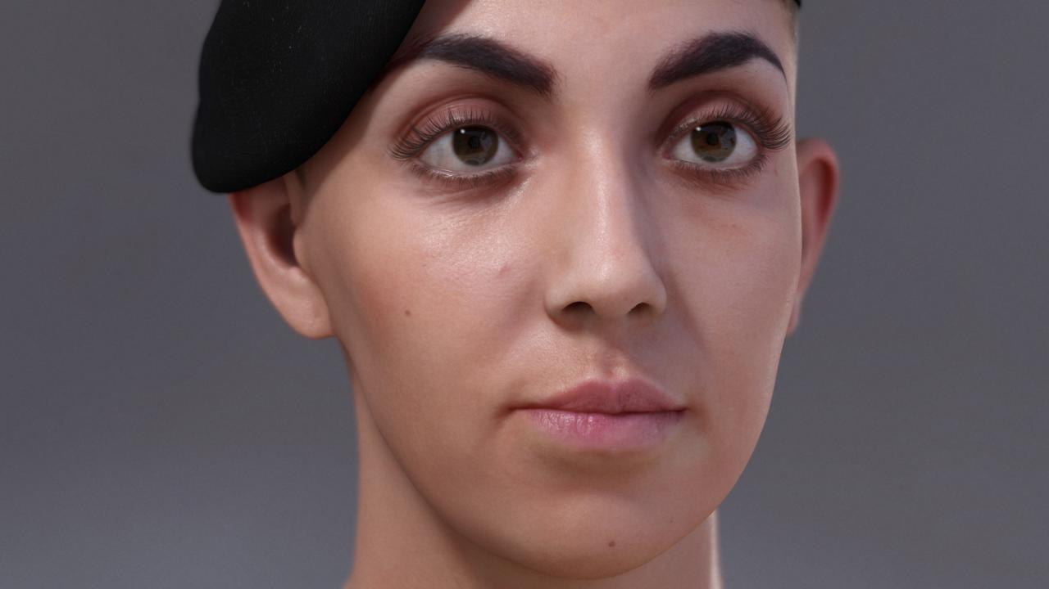
© Activision Blizzard
Notes:
So, let me present Lauren, one of our test characters, rendered at 180 frames per second.
(On a GeForce GTX 680 at 720p, using SMAA T2x.)
There are many things important for character rendering.
For example, the modeling, the shadows, the eyelashes…

Slide 9
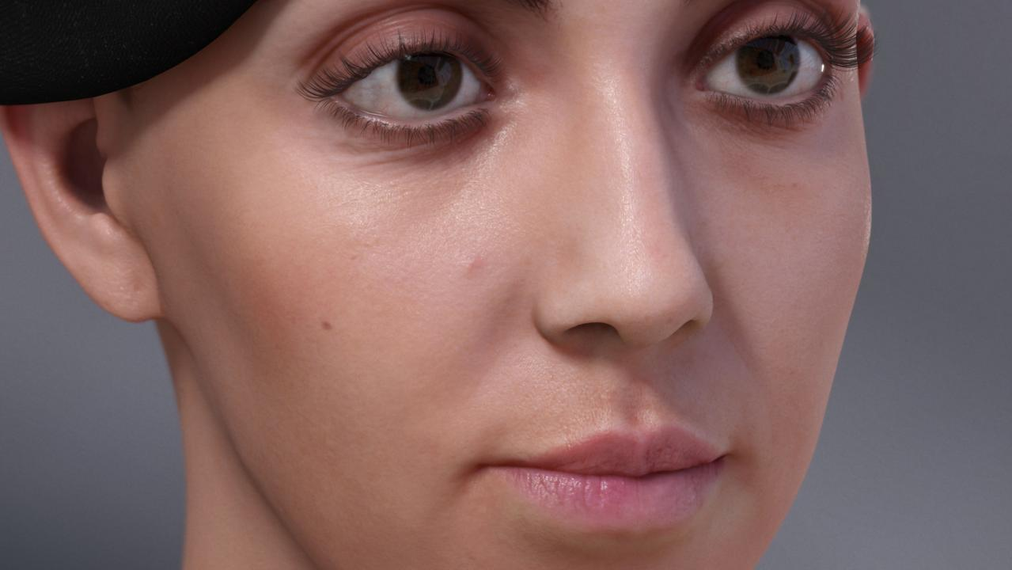
© Activision Blizzard
Notes:
…the specular reflections, the occlusion, the skin, post fx and of course…

Slide 10
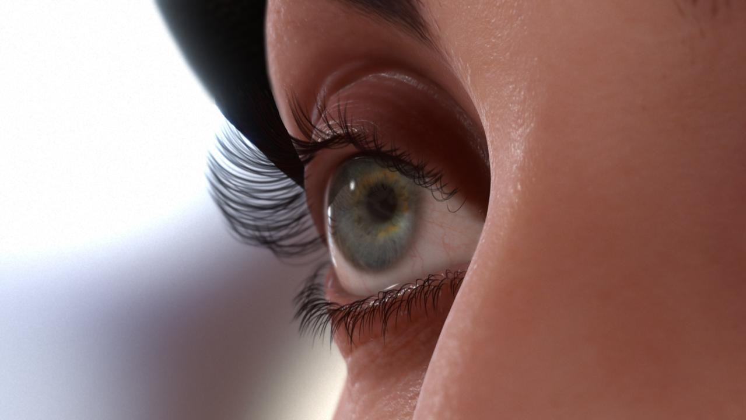
© Activision Blizzard
Notes:
…the eyes.
Described as “windows to the soul”, they are, in my opinion, of extreme importance for showing emotions.
Notice that, to a certain degree, we manage to maintain realism even in tight macro shots, with very fine skin details.

Slide 11
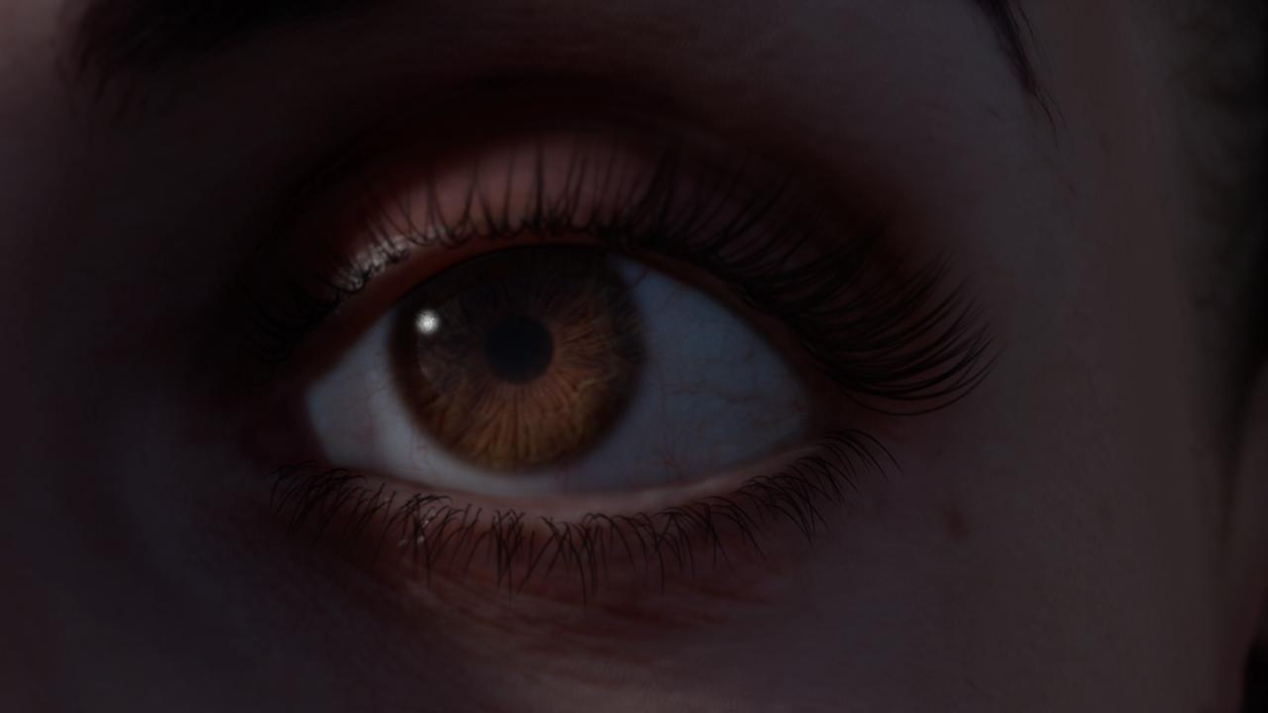
© Activision Blizzard
Notes:
Here you can see the light transport in the eyes, including light refraction,
and the smooth colored shadows on the top of the eye, produced by subsurface scattering.

Slide 12
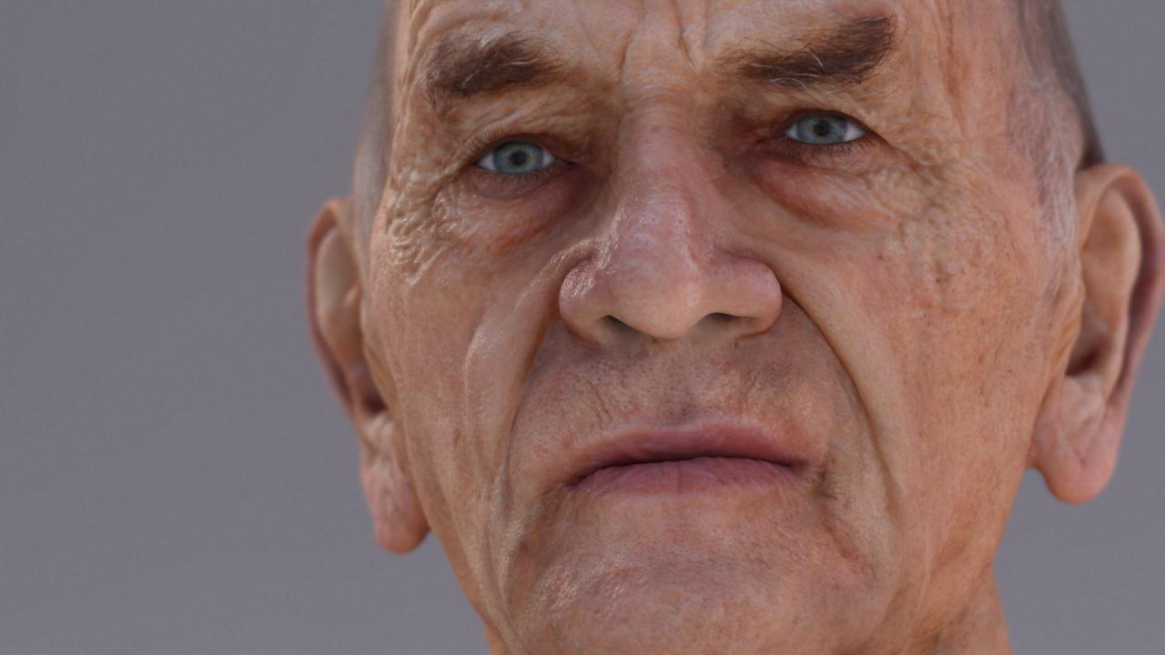
© Activision Blizzard
Notes:
In this one, you can see the power the eyes can have for showing emotion,
the soft specular reflection of old skin, and the importance of depth of field in portrait shots.

Slide 13
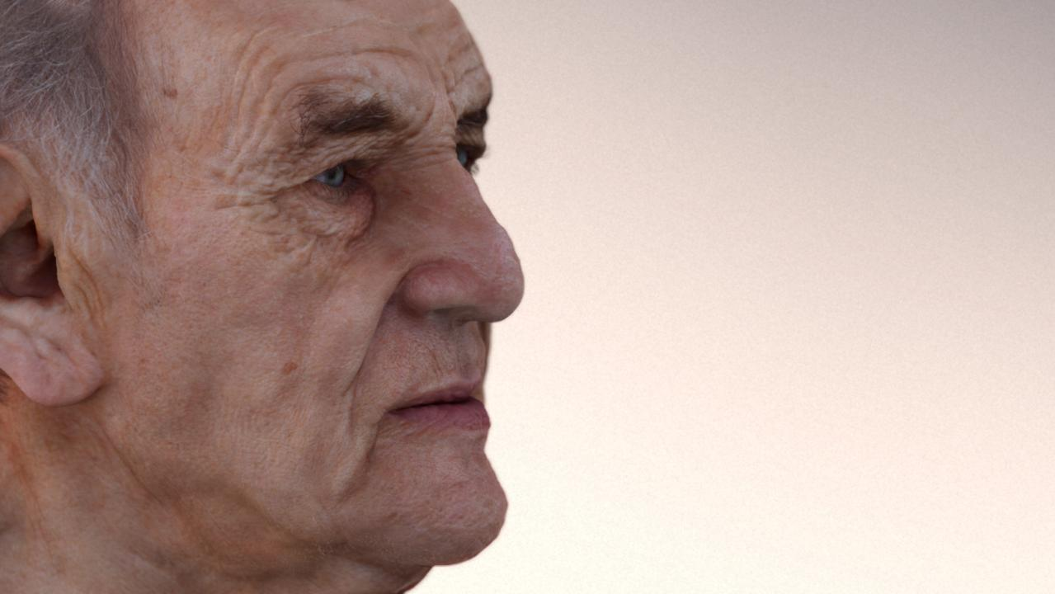
© Activision Blizzard
Notes:
This shows how soft lighting can further reduce the specularity of a face…

Slide 14
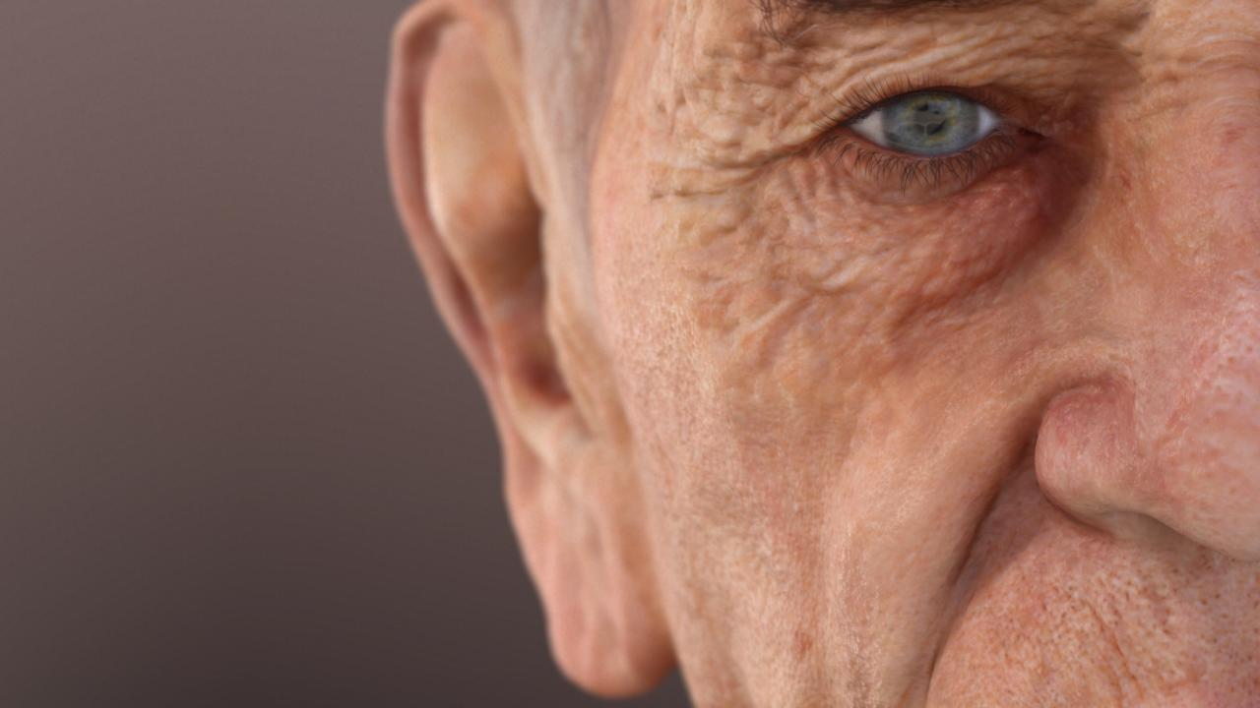
© Activision Blizzard
Notes:
…and how important the eyes can be in a composition.

Slide 15
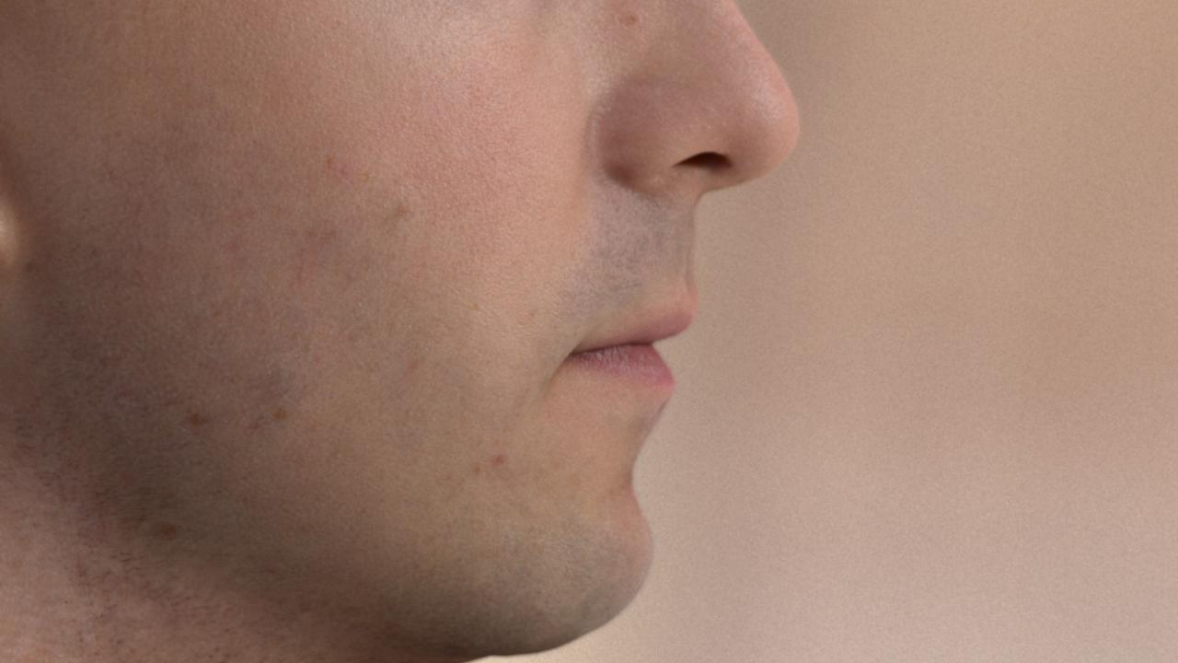
© Activision Blizzard
Notes:
See the soft diffuse lighting, together with strong specular bumps,
and how film grain can add realism to a character shot.

Slide 16
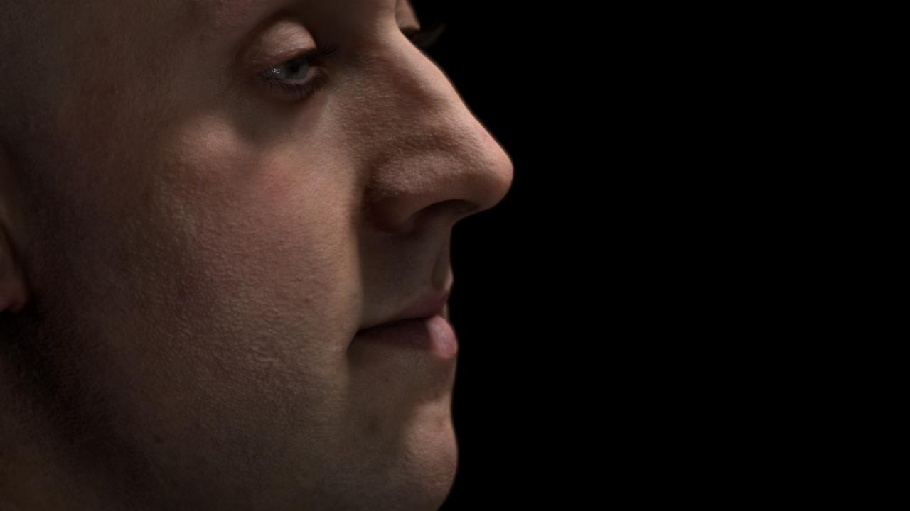
© Activision Blizzard
Notes:
There is much to say about this one.
Notice the strong features of the skin, and how smooth it looks at the same time.
Achieving this, is for me, one of the biggest challenges we faced.
Also look at the reflections in the eyes, and how they reveal how wet they are,
which can help to convey a character's emotional state.

Slide 17

© Activision Blizzard
Notes:
And last, but not least, notice how the light is travelling through the nose of the character,
how light is refracting in the eyes, and the subtle, yet noticeable pore detail in the face.

Slide 18
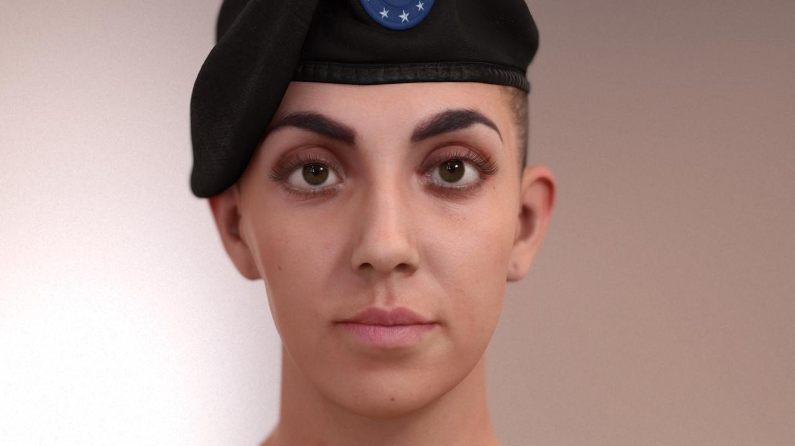
On
© Activision Blizzard
Notes:
I’m going to show you some images, turning on and off everything we do that's special for character rendering.

Slide 19
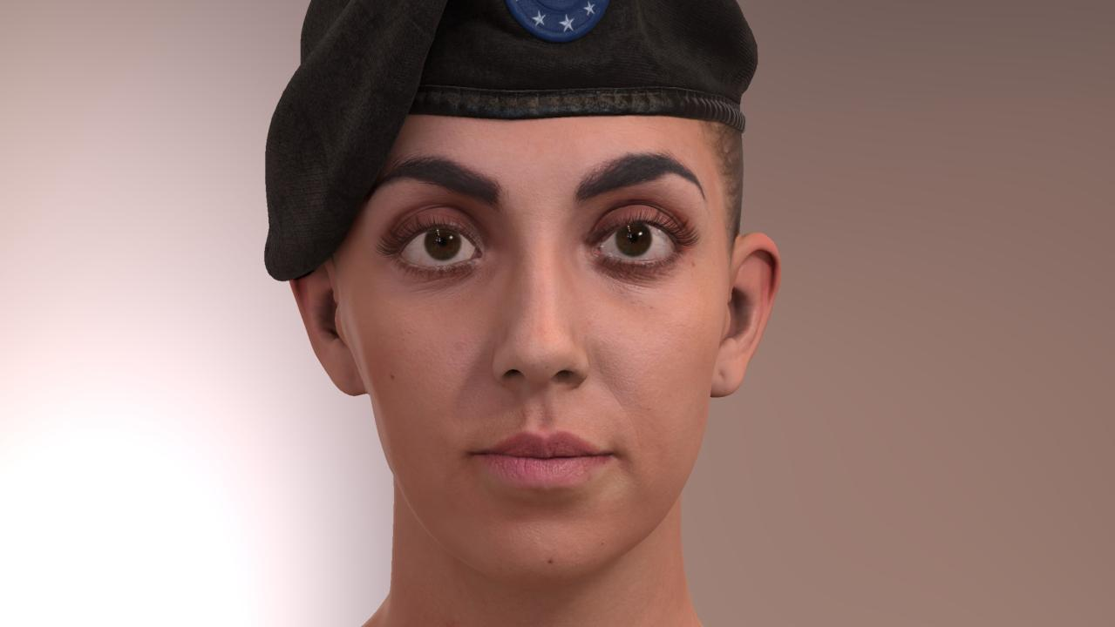
Off
© Activision Blizzard
Notes:
So this is the first one.

Slide 20
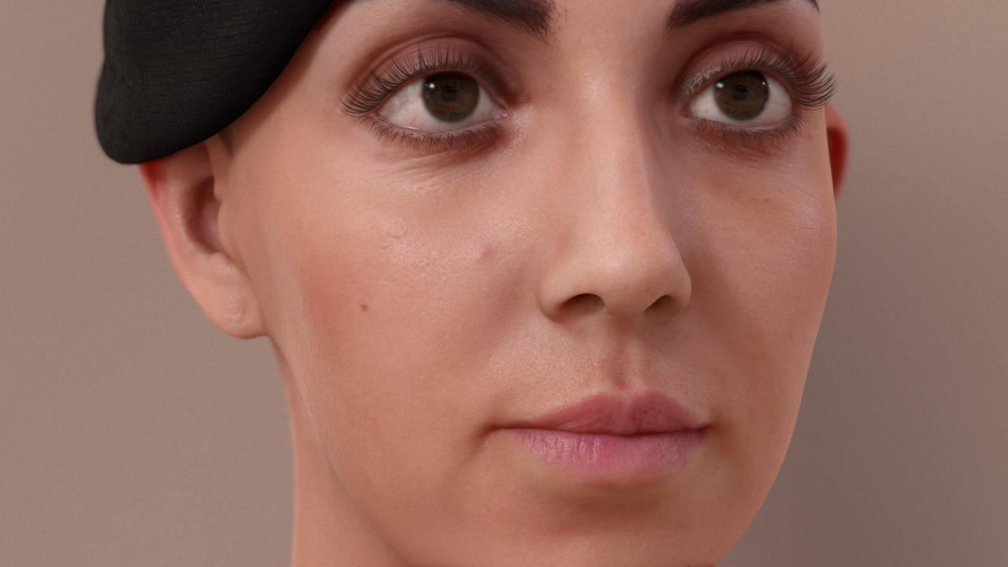
On
© Activision Blizzard
Notes:
Notice how the character turns into…

Slide 21
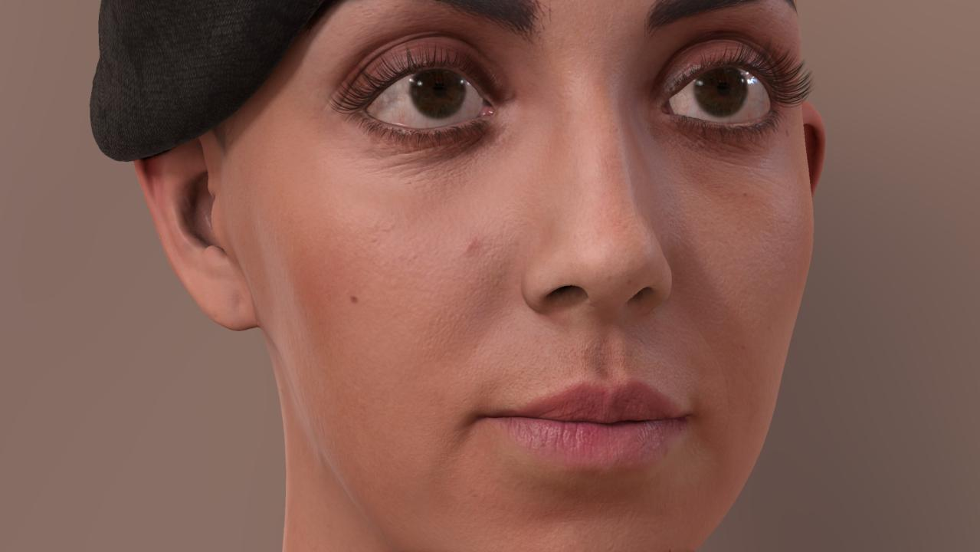
Off
© Activision Blizzard
Notes:
…a doll when we turn off our special rendering features.

Slide 22
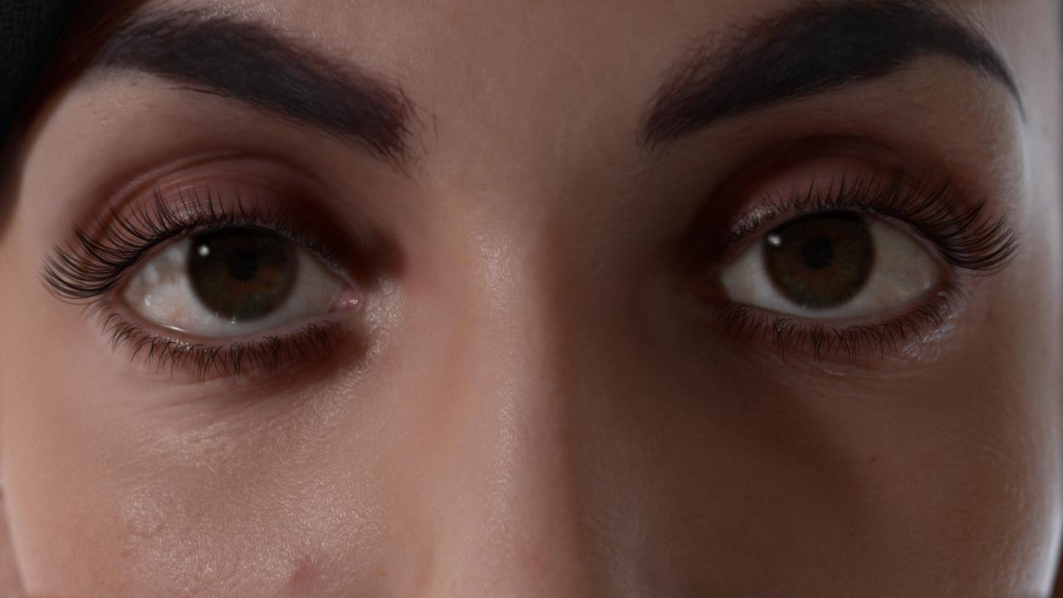
On
© Activision Blizzard
Notes:
They are especially important…

Slide 23
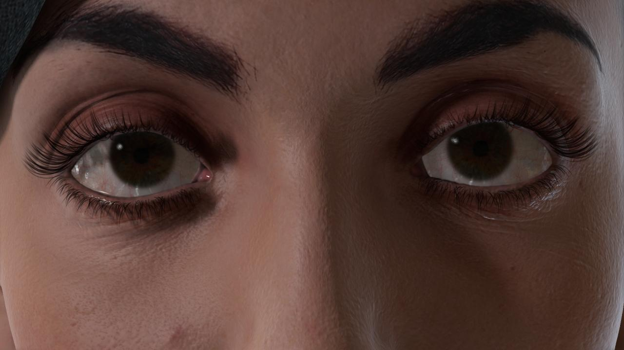
Off
© Activision Blizzard
Notes:
…the closer you are to the character.

Slide 24
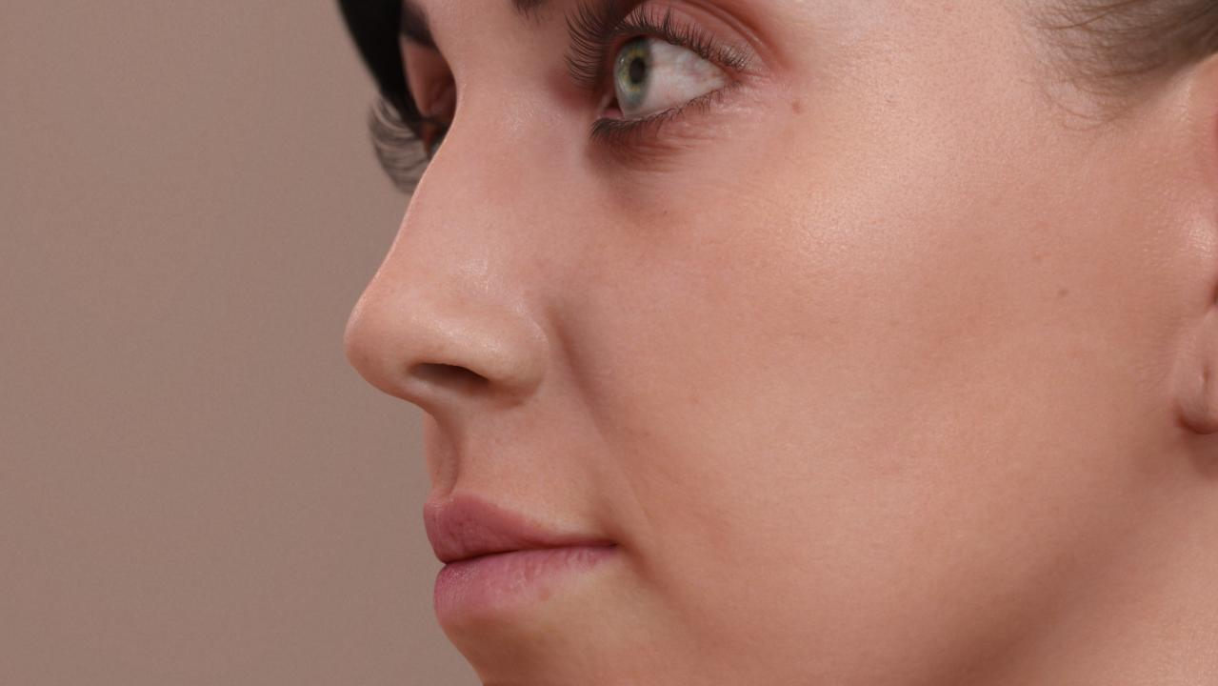
On
© Activision Blizzard
Notes:
Look at the refraction in the eyes…

Slide 25
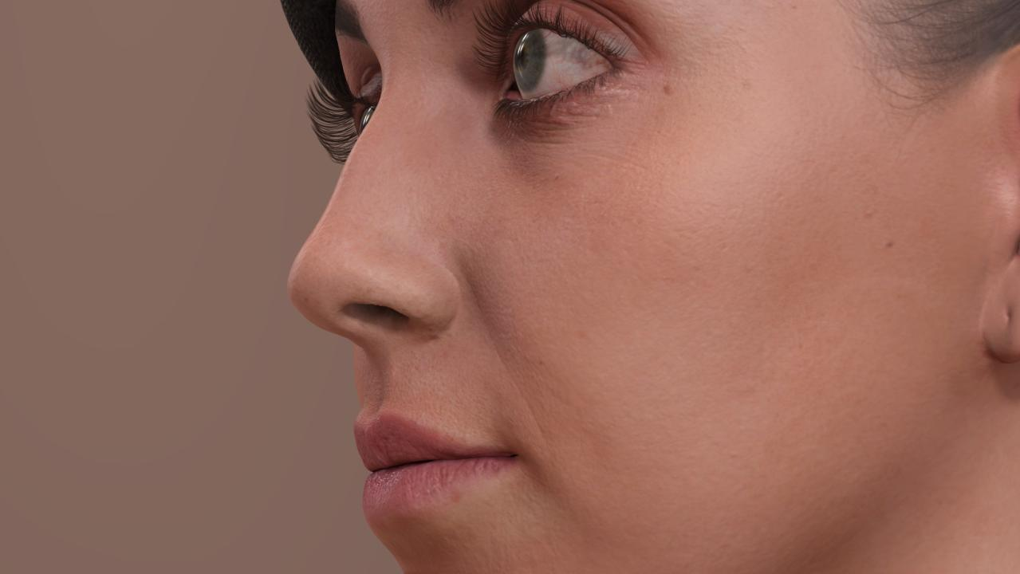
Off
© Activision Blizzard
Notes:
…and the specular details.

Slide 26
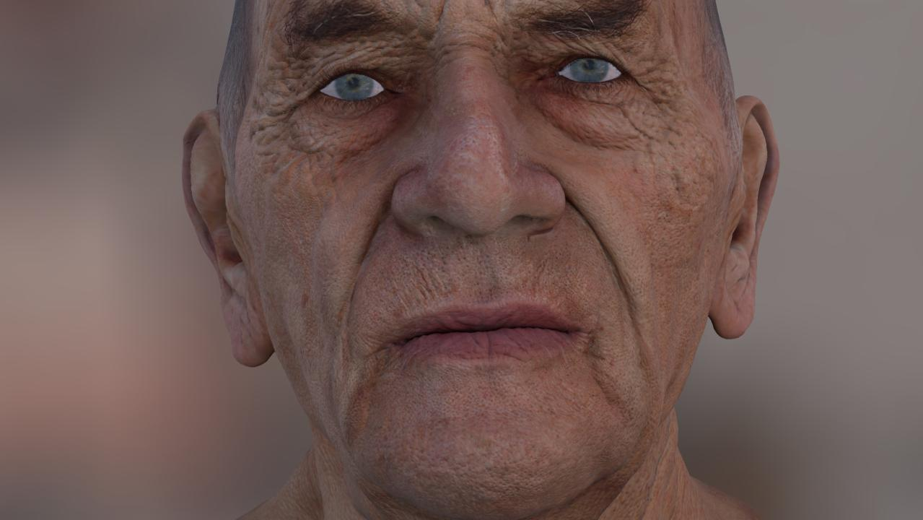
Off
© Activision Blizzard
Notes:
In my opinion, this technology has the potential to take a current generation character…

Slide 27
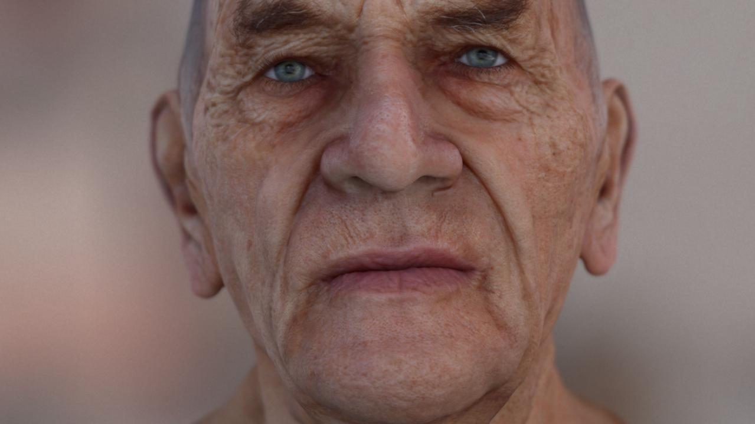
On
© Activision Blizzard
Notes:
…to the next generation life.

Slide 28
What’s going on?
In the real world, nothing is perfect
Too perfect renderings look unrealistic
Fastest route to the uncanny valley

Slide 29
Art Surpassing Tech
Ultra Detailed Meshes +
Naive Technology =
Uncanny Valley
Notes:
The level of detail of characters has steadily increased in the past few years.
There are now many games with incredibly beautiful and detailed faces.
Unfortunately, if we don’t raise the technology to the same level, what you will get is again...

Slide 30
Uncanny Valley
© Activision Blizzard
Notes:
...this.

Slide 31
High level features of the renderer
Linear lighting workflow
Physically based lighting
Heavy post-processing
1-5 procedural lights and 1 pre-filtered probe light (256x256)
Notes:
The main goal of our renderer was robustness.
To achieve that, we’re using a linear lighting workflow, physically based lighting, and a special post-effects pipeline.
We used between one to five procedural lights and one pre-filtered probe light,
but we found that a single procedural light (together with the probe light) is usually enough.

Slide 32
Skin Rendering
Skin Rendering
Skin Reflections
Human Pores
Global Illumination
Subsurface Scattering
Eyes Rendering
Post FX
Notes:
The render part of the presentation has three parts:
Skin, eyes and post effects.
So, let’s begin with the first part.
The skin.

Slide 33
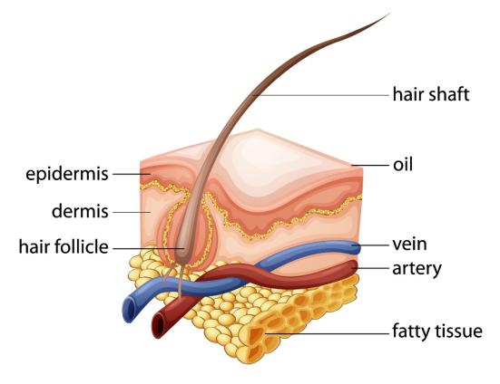
The Skin
Global Illumination
Specular Reflections
Subsurface Scattering (SSS)
Notes:
For us, skin rendering has three main components.
First: light bounces from some parts of the face onto others – i.e., global illumination.
Second: part of this light reflects off the oily layer of the skin.
And finally: the remaining light enters the skin and scatters, which is a phenomenon called subsurface scattering.

Slide 34
Specular Reflections
Skin Rendering
Skin Reflections
Human Pores
Global Illumination
Subsurface Scattering
Eyes Rendering
Post FX
Notes:
I’ll start with the specular reflections.

Slide 35
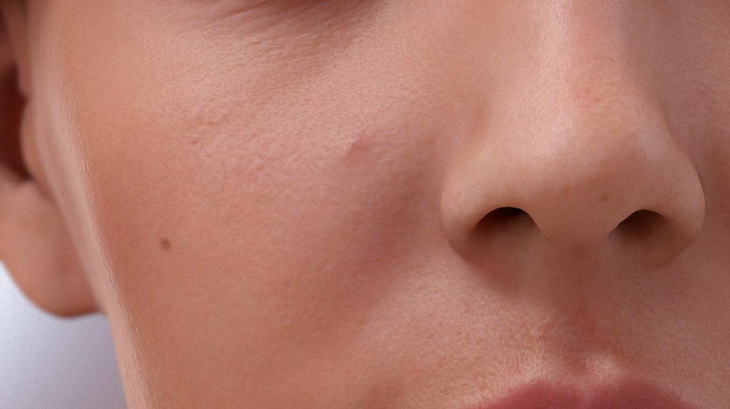
Regular shading
© Activision Blizzard
Notes:
So, what’s the problem with the specular?
For us, it’s that it looks like plastic.
So, how can we break this appearance, and turn it into something like…

Slide 36
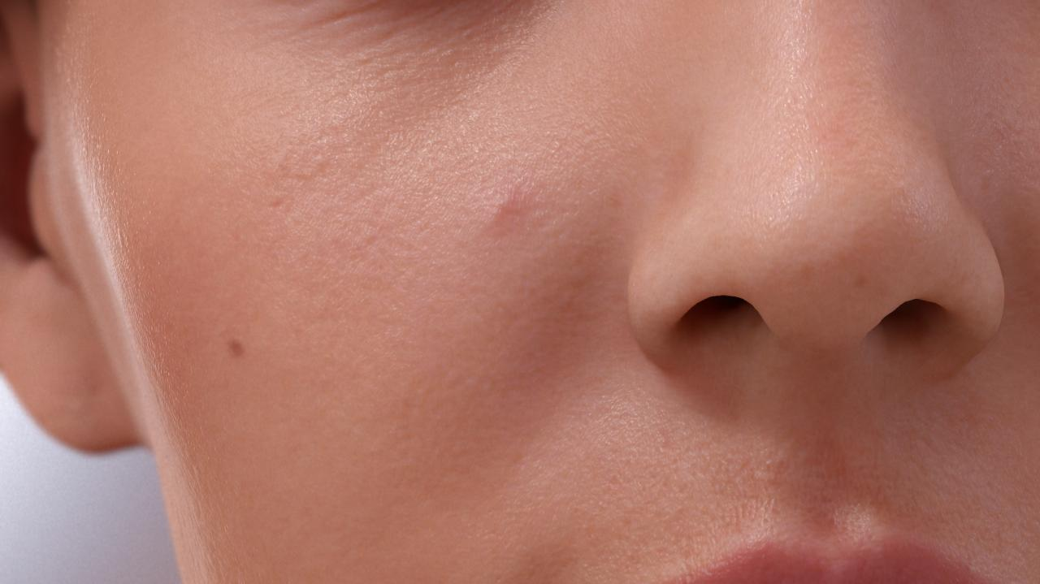
Our Specular Shading
© Activision Blizzard
Notes:
This?

Slide 37
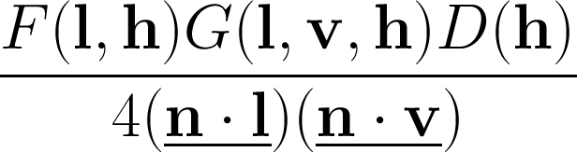
Physically based Specular
Black Ops 2 physically based specular BRDF for direct lighting
Improved version of Black Ops specular model, see [Lazarov2011] - Physically-based lighting in Call of Duty: Black Ops
Indirect specular using a pre-filtered cube map
http://seblagarde.wordpress.com/2011/08/17/hello-world/
Thanks to Dimitar Lazarov and Sébastien Lagarde for sharing the code
Notes:
We begin with the production-proven Black Ops 2 specular model as the foundation.
It’s physically based, which means it ensures accurate results with no manual tweaks.
(Many thanks for the support of to Dimitar Lazarov, who answered every single question we had and to Sébastien Legarde, for the countless email threads and interesting discussions)

Slide 38
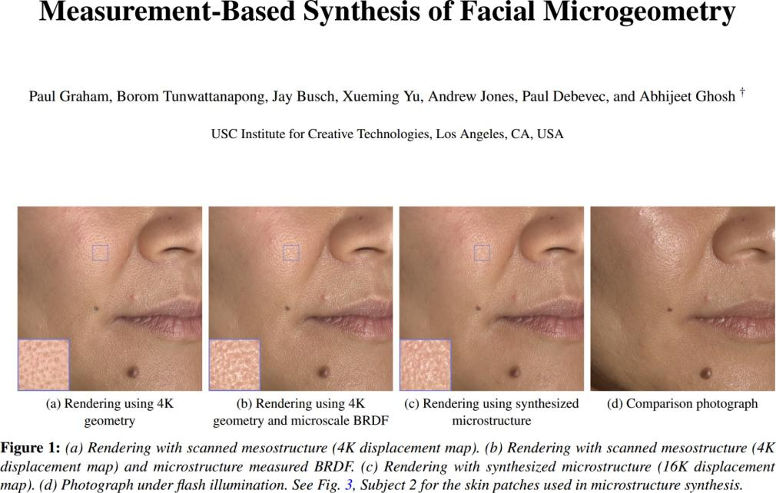
Notes:
Using this model, we tried to mimic the results from a state-of-the-art technical report from the ICT (Institute of Creative Technologies), where they describe a very accurate skin capture system.

Slide 39
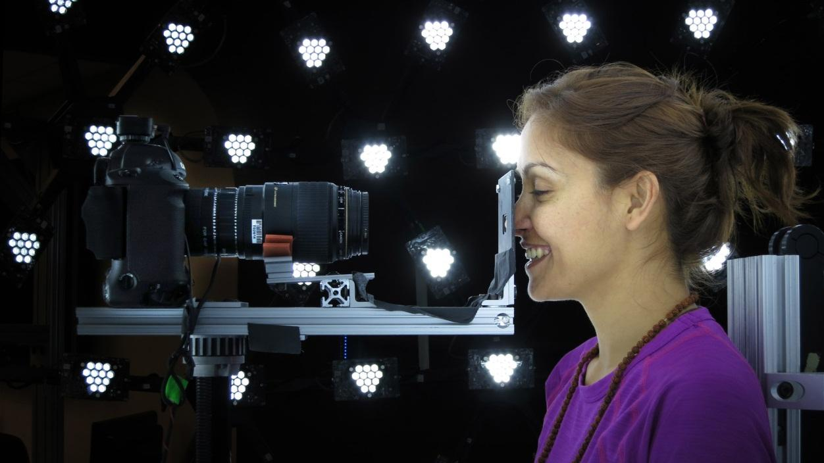
Institute of Creative Technology Capture
Notes:
In summary: they capture micro-scale details for tiny patches of the skin – in this case the nose – and smartly clone it over the face, which allows us to accurately capture the skin reflection structure and properties.

Slide 40
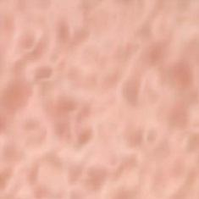
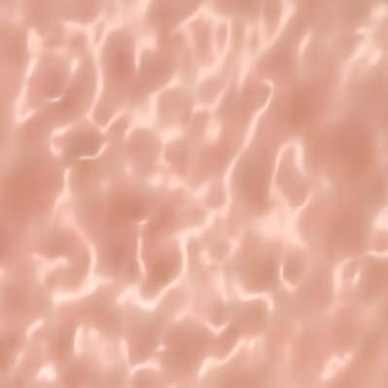
Two Lobes Rendering (ICT Reference)
Lobe 2
Lobe 1
Regular
Microstructure BRDF Fit
From [Graham2013] Measurement-Based Synthesis of Facial Microgeometry
Notes:
In my opinion, one of the key contributions of the paper is that it reveals the importance of having two specular lobes for rendering skin.
They obtain the lobe parameters using fitting techniques, but we managed to get similar results by visually adjusting them…

Slide 41
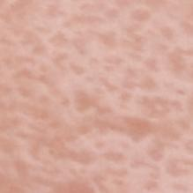
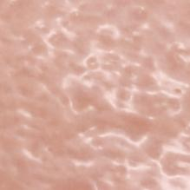
Two Lobes Rendering (Our Render)
One Lobe
Two Lobes
Notes:
…and as you can see in this comparison, the results are quite similar.
[Back and forth]

Slide 42
Two Lobes Rendering (Our Render)
Lobe 2
Lobe 1
One Lobe
Two Lobes
Notes:
Rendering with two specular lobes instead of a single one is critical for accurately rendering skin reflections.

Slide 43
One Lobe
© Activision Blizzard
Notes:
Here you can see the difference of using one lobe…

Slide 44
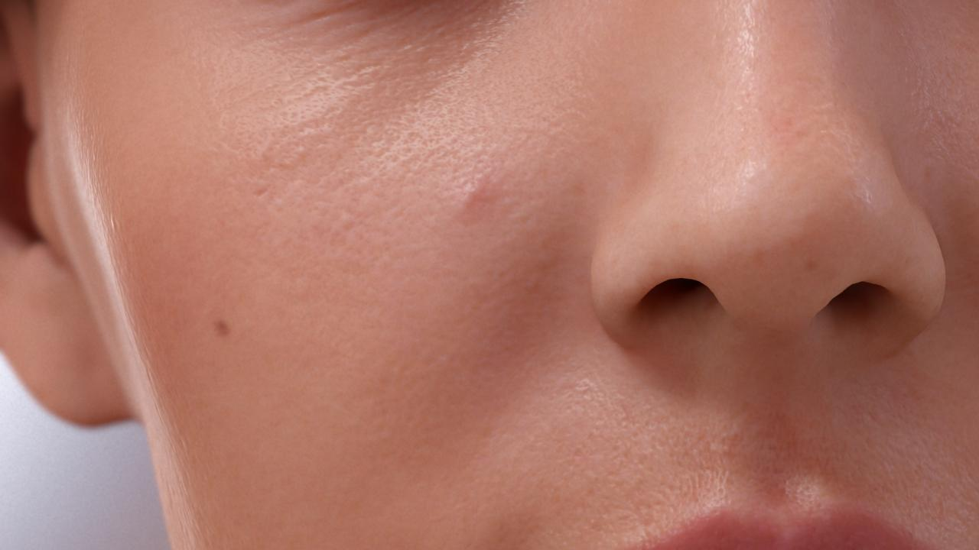
Two Lobes
© Activision Blizzard
Notes:
…versus using two.
[Back and forth]

Slide 45
Implementation Details
Linear blend between two specular lobes:
85% for lobe 1
15% for lobe 2
Specular power for lobe 2 derived from first one (avoids using two gloss maps)
Notes:
In this slide you have some numbers we used for the two-lobe specular parameters.

Slide 46
Performance
Only two extra instructions per light for vector-based architectures
Notes:
You may be thinking “this is going to be expensive!”, but I’ve got good news!
By using proper vectorization, this only adds two instructions per light.
(But unfortunately, this only applies to vector-based architectures)

Slide 47
Microgeometry Render (ICT Reference)
Microstructure BRDF Fit
From [Graham2013] Measurement-Based Synthesis of Facial Microgeometry
Notes:
Diving further into the technical details of the ICT paper, you can see that
they not only fit the BRDF using captured microgeometry…

Slide 48
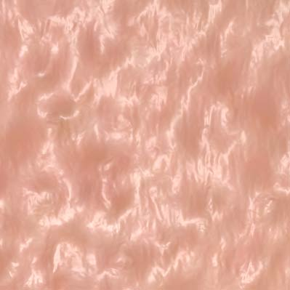
Microgeometry Render (ICT Reference)
Microstructure BRDF Fit
Microstructure Render
From [Graham2013] Measurement-Based Synthesis of Facial Microgeometry
Notes:
…but actually render with it.
Notice how the microstructure pattern breaks the synthetic appearance of the reflections.
Again, we wondered if we could find a plausible solution for real-time.
If you look closely at the microstructure distortions, you’ll notice that they look pretty much sinusoidal.

Slide 49
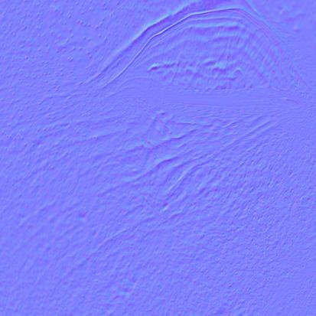
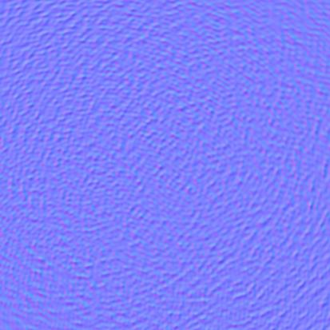
Sine-Based Tiled Procedural Bump
+
Base Map
Micro-Detail Map
Scale is exaggerated for illustration purposes
Notes:
So, we thought: why not perturb the original base map with tiled sinusoidal noise?

Slide 50
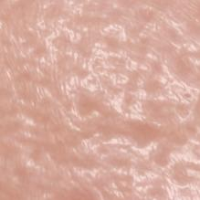
Microgeometry (Us)
Notes:
We found this simple approach to yield very good results.

Slide 51
Microgeometry (ICT Reference)
From [Graham2013] Measurement-Based Synthesis of Facial Microgeometry
Notes:
Here you have the ICT reference… [Back and forth]
Again, the result is good enough for our purposes.

Slide 52
Two Lobes
© Activision Blizzard
Notes:
Here we have a render with two lobes…

Slide 53
Two Lobes + Microgeometry
© Activision Blizzard
Notes:
…and here with two lobes and microgeometry noise.

Slide 54
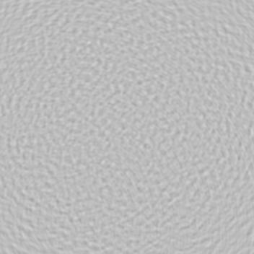
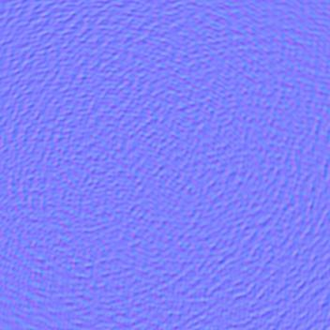
Sine-Based Tiled Procedural Bump
Height Map
Normal Map
Notes:
For creating this noise map, we used 100 radial sinusoidal generators to
produce a height map, which was then converted to a normal map using NVIDIA Texture Tools.
This same texture was also useful for the eyes, as we’ll see later on.
Notes on the equation (for a 1024x1024 texture):
It is a sum of randomly positioned sine waves with each having a different frequency.
The variables p_x and p_y are the pixel positions in [1,1024].
The rand() functions inside of the sqrt (same for all pixels) defines the center of the i-th sine wave in [1,1024].
Last rand() (same for all pixels) controls the frequency of the i-th sine wave.

Slide 55
How to Blend Them
Ideally the detail normal should perturb the base normal (not just blend)
Reoriented Normal Mapping (RNM) is perfect for that!
http://blog.selfshadow.com/publications/blending-in-detail/
Thanks to Stephen Hill and Colin Barré-Brisebois for sharing the code/technique
Notes:
For blending, we modified the base normal using reoriented normal mapping, which gave very good results.

Slide 56
Skin Gloss Map
What is roughness?
Notes:
Something important related with microgeometry is roughness.

Slide 57
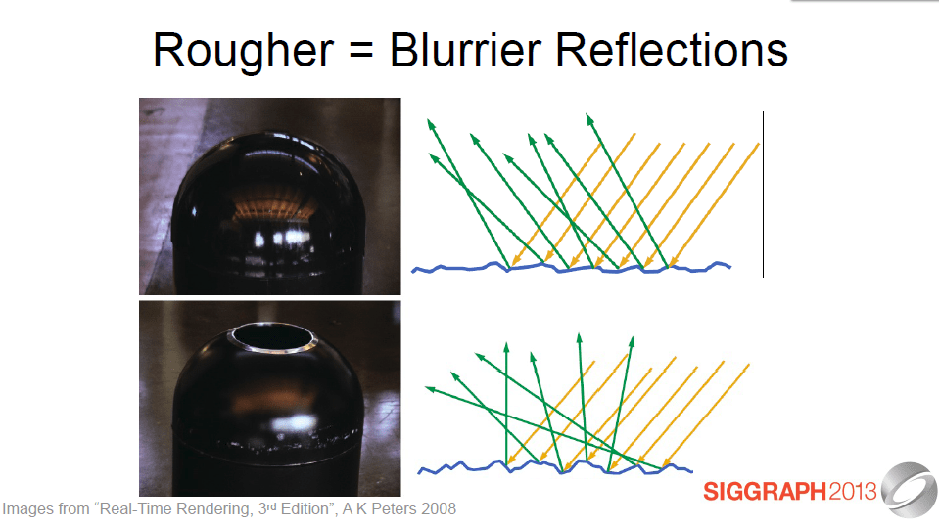
Reflected light
Incoming Light
Microfacets
From [Hoffman2013] Background: Physics and Math of Shading
Notes:
The roughness of a material depends on how flat or randomly oriented are its microfacets.

Slide 58
Reflected light
Incoming Light
Microfacets
From [Hoffman2013] Background: Physics and Math of Shading
Notes:
A glossy material, as seen on the top, will have a flat surface at microscopic level, leading to sharp reflections.

Slide 59
Reflected light
Incoming Light
Microfacets
From [Hoffman2013] Background: Physics and Math of Shading
Notes:
On the other side, a rougher material will have a more random distribution of facets, as shown in the bottom, leading to blurrier reflections.

Slide 60
Microgeometry are Microfacets
Notes:
And this where things get interesting.
Our microgeometry is small enough to be considered microfacets if we look at the skin surface from far away.

Slide 61
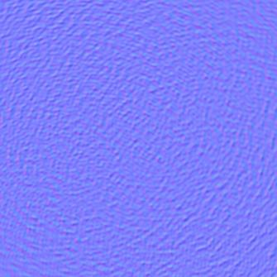
Skin Gloss Map
Microstructure tiled bumps convert to roughness when observed from far away
Micro-Detail Map
Notes:
This means that our tiled normal map can convert to roughness when we see the head from far away.

Slide 62
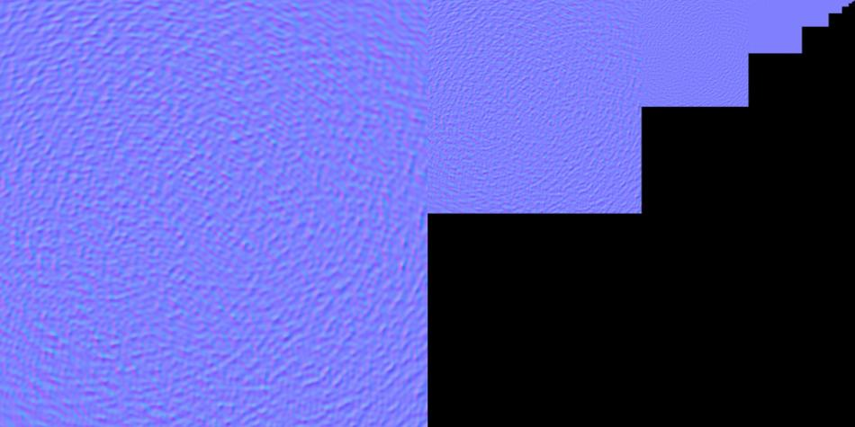
Tiled Bumps
Flat
Notes:
Just to show it with an example, here we have the normal mip-maps.
As you can see, the normals flatten with distance.

Slide 63
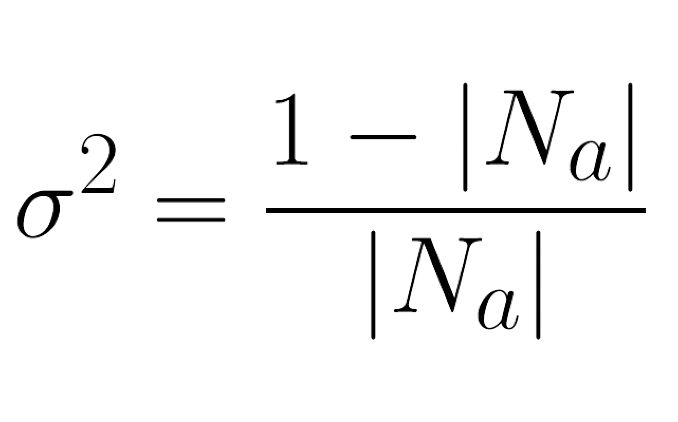
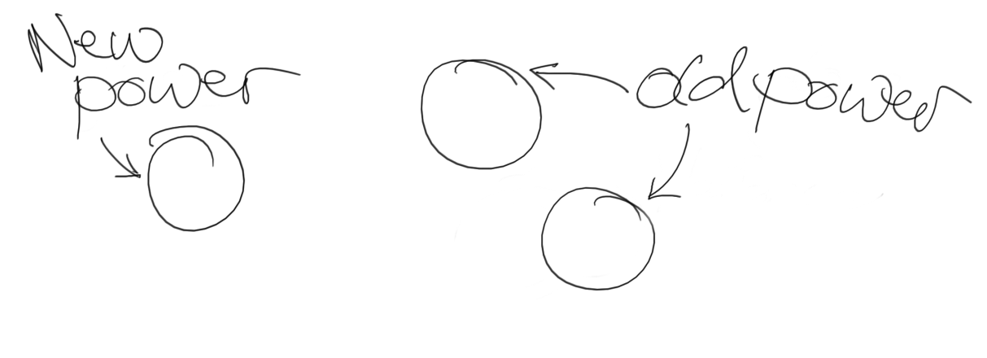
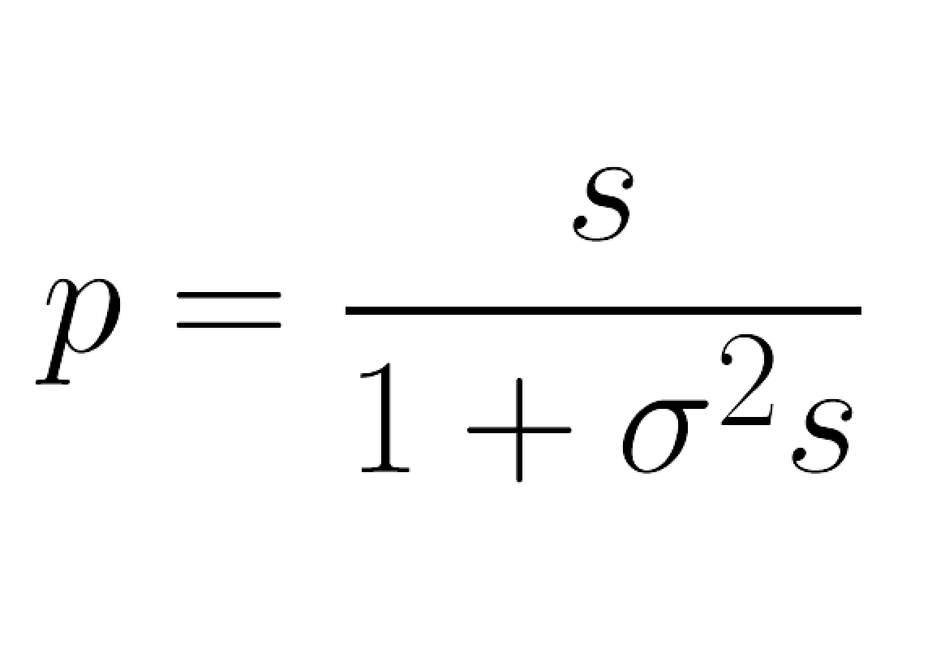
Variance to Gloss
Estimate normal variance, and use it as glossiness
More details on the reference below
From [Hill2012] Rock-Solid Shading: Image Stability Without Sacrificing Detail
Notes:
We can convert this normal map into a gloss map by estimating normal variance…

Slide 64
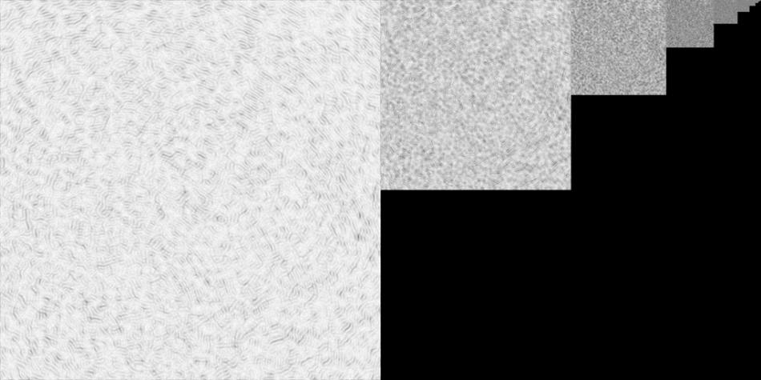
Tiled Gloss
Noisy
Thanks to Stephen Hill for this map example
Notes:
…obtaining this result.
We are then obtaining a physically plausible gloss, instead of relying on painted maps, which some times, have no real meaning from a physical-based rendering stand point.
Notice how the gloss noise, unlike the normal map one, is present even when far away from the model.

Slide 65
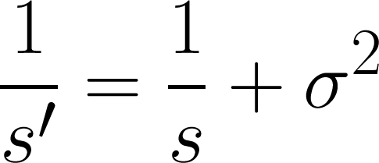
Dealing with Detail Maps
Combine base glossiness with detail variance:
Base glossiness assumed to contain base normal map variance
You will get sweaty heads when you are far away otherwise!
More details in [Hill2012] Rock-Solid Shading: Image Stability Without Sacrificing Detail
Notes:
But we still want to have some control on the base gloss of each part of the face. So, we will have now two sources of glossiness: the artist authored gloss map and the gloss values obtained from the tiled noise.
For combining them, we need to store the noise variance alongside with the normals,
and combine it with the original artist authored gloss map.
We refer you to Stephen Hill and Dan Baker’s presentation about specular antialiasing for more details.

Slide 66
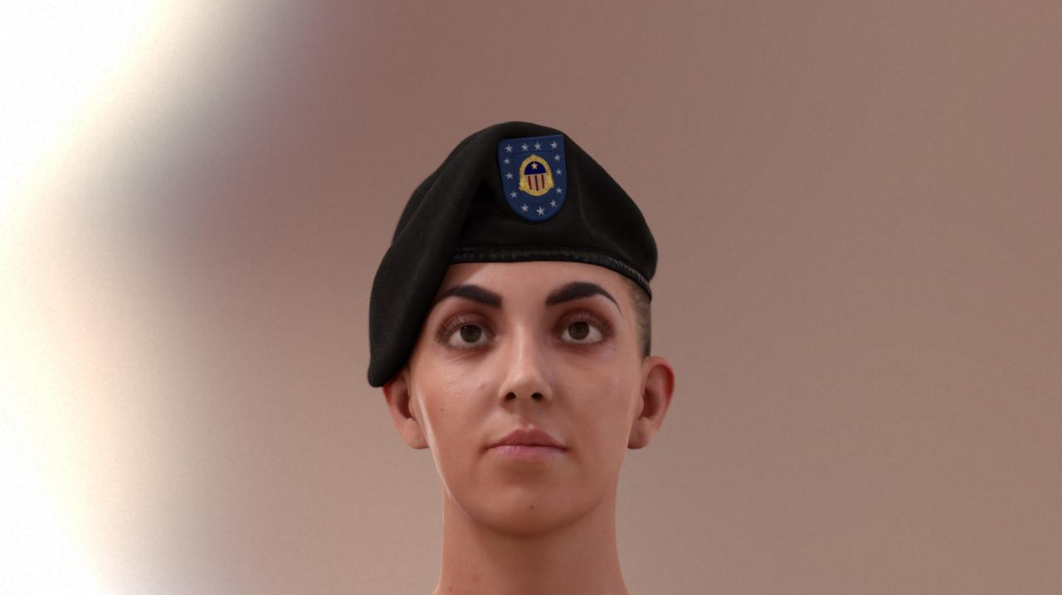
With Normal Map Variance to Gloss
© Activision Blizzard
Notes:
We want to highlight the extreme importance of taking specular antialiasing seriously.
If you don’t…

Slide 67
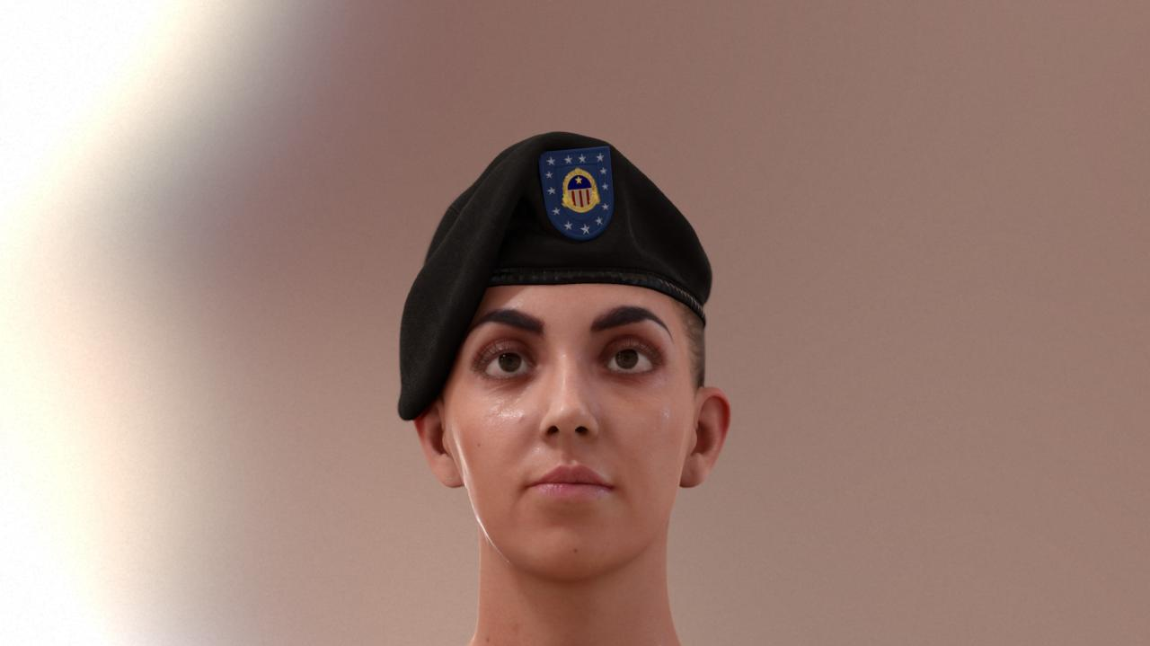
Without Normal Map Variance to Gloss
© Activision Blizzard
Notes:
…you will end up with sweaty faces when you look at them from far away.
Even if they are not sweaty in a close up.
(Previous slide was normal map variance in action)

Slide 68
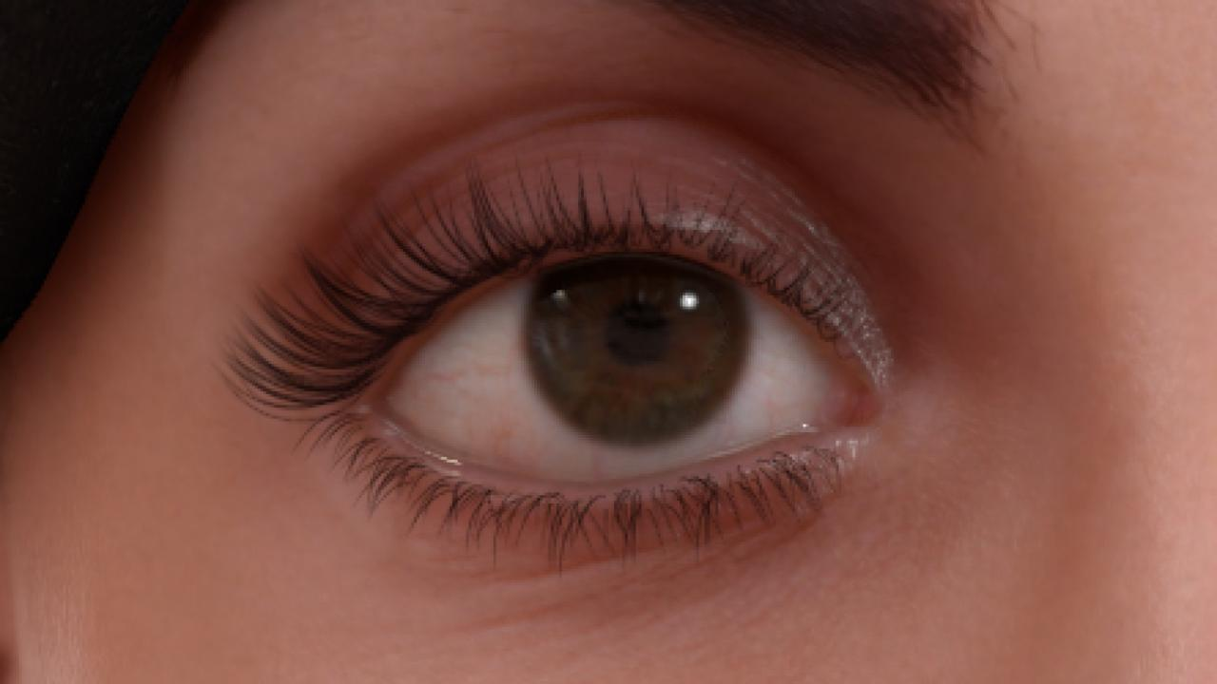
With Geometry Variance to Gloss
© Activision Blizzard
Notes:
Geometry normal variance is important as well, especially for the eye wetness geometry.
(More on the geometry itself later on.)
Without it…

Slide 69

Without Geometry Variance to Gloss
© Activision Blizzard
Notes:
…you end with an unbearable amount of aliasing, given the high specular power used for this area.

Slide 70

Gloss Map Authoring
Normals:
Normal map contain meso details (medium frequency)
Detail tiled noise normal map for micro details (high frequency)
Gloss:
Only low frequency details
High frequency details come from variance to gloss (both from normal and detail normal maps)
Improves the workflow
Notes:
As a final comment on this, our recommendation is to author low-frequency details in the gloss map, and then add microdetails using tiled bump/gloss.
In the end, the noise texture allows for very intuitive map editing, as an artist only has to paint low-frequency gloss changes.
High-frequency details are automatically generated on the fly from the tiled microstructure texture.

Slide 71

(First Lobe) Gloss Map
 | Spec. Power S | Gloss G (Scale=14)
Main | 26.5 | 86
Lips | 111.43 | 124
Upper Lip | 18.37 | 76
Nose | 38.49 | 96
Ear (Main) | 10.07 | 61
Ear (Near the hole, wax) | 61.1 | 108
Eye (Top) | 44.22 | 100
Eye (Bottom) | 80.63 | 115
Caruncle | 31288 | 255
Eyelid (Top) | 73.51 | 113
Eyelid (Bottom) | 512 | 164
Notes:
In this slide you have the values we used for authoring the gloss for the first lobe, both as specular power and log-encoded.
More details in [Lazarov2011] - Physically-based lighting in Call of Duty: Black Ops.
The second lobe should be either 2.0*G or S^2.0.
Using the “Main” gloss preset for the whole face works surprisingly well.
These values work well for regular skin, but not for old skin (for instance), which is usually more dry.
In case of sweat, the forehead, cheeks and nose should typically have higher gloss values, since they contain larger pores than other facial areas, and thus sweat is more intensively produced in those zones.
In particular, the forehead and the nose are part of the T-zone, which is usually more glossy than the rest of the face in the case of people with oily skin.
Some notes:
The image colors on the right won't match the values in the second column, they are only shown for illustration purposes
The values are intended for the Black Ops 2 BRDF specular model, so they may need to be adjusted for other models
Gloss G has a range of 0 - 255

Slide 72

Small Area Light
© Activision Blizzard
Notes:
I’d like to also highlight how hard authoring gloss can be, as it depends a lot on the lighting setup.
The size of the light, and its distance is something to take into account.
Here we have a point light source…

Slide 73

Big Area Light
© Activision Blizzard
Notes:
…and here a bigger area light.
Notice how specular reflections have softened.
We like to think of gloss and the size of the light as two sides of the same coin, as they both blur/sharpen the specular highlights.

Slide 74

Harsh Probe Light
© Activision Blizzard
Notes:
With probe lighting it can get even less predictable (and hence, we recommend authoring with procedural lighting).
This is a harsh probe lighting setup…

Slide 75

Soft Probe Light
© Activision Blizzard
Notes:
…and this is a softer one.
The degree to which the specular ‘pops’ depends on the input.
It’s very easy to adjust the gloss to make this happen all the time, but in reality this is wrong.
Specular highlights should only be visible if there is a very strong directional light source somewhere.
(Strong with respect to the rest of the environment.)
This makes specular more difficult to author in a robust way.
Authoring for a single direct light is possibly the best option.

Slide 76
Combinatory Parameter Explosion
Diffuse Albedo
Specular Gloss (with visual changes depending on light size, making it even harder to author)
Specular Albedo
Ambient/Specular Occlusion
Easy to find a solution for a single lighting configuration
Extremely hard to find a solution that works all time
Notes:
For me, the takeaway is that there are too many parameters that control the appearance of a material.
It’s easy to find a solution for a particular lighting configuration, but extremely hard to find something that works all time.

Slide 77

Notes:
One of the aspects we worked on is the percentage of diffuse reflection for various character parts.
For this we created a reference chart for artists, using spectral measurements (which should be fairly accurate).
We think that when using a physically based render system, we should provide a range of good values to artists, as this is probably the main advantage of such a system.
(Note that sclera color is not correct. Unfortunately it’s based on an in-vitro experiment, which means that the eye was dead tissue.)

Slide 78
Human Pores
Skin Rendering
Skin Reflections
Human Pores
Global Illumination
Subsurface Scattering
Eyes Rendering
Post FX
Notes:
Now, to the next topic, human pores.

Slide 79

www.theworldcloseup.com
Photography: Steve Gschmeissner
Notes:
This beautiful image is a scanning electron micrograph of a human pore, taken by Steve Gschmeissner (www.theworldcloseup.com).
Notice that there is a lot occlusion happening there.
You may be thinking that this completely irrelevant for rendering. We thought the same…
(Photograph used with the permission of Steve Gschmeissner)

Slide 80


Comparing with Reality
Render
Photograph
From [Graham2013] Measurement-Based Synthesis of Facial Microgeometry
Notes:
…but we were wrong!
If we compare a render with a photograph…

Slide 81


Comparing with Reality
Render
Photograph
From [Graham2013] Measurement-Based Synthesis of Facial Microgeometry
Notes:
…you will notice that we’re getting specular reflections inside of the pores.
In general this is not physically possible, as there is a hole in the pore.

Slide 82

Cavity Specular Occlusion
Notes:
So, to solve this, we thought a good idea would be to use a cavity map, using it as a specular occlusion term.

Slide 83

Off (Good Case)
© Activision Blizzard
Notes:
Here we have a comparison…

Slide 84

Off (Good Case)
© Activision Blizzard
Notes:
…and you can see how using the cavity map further breaks the specular pattern, adding more imperfections to the skin appearance.
(Microgeometry effect diminished to better showcase cavity map effect.)

Slide 85

Off (Good Case)
© Activision Blizzard
Notes:
This helps to add occlusion to the pores, which is important for ambient lighting…

Slide 86

On (Good Case)
© Activision Blizzard
Notes:
…as you can see on this slide [back and forth].
Here we’re using the default cavity map straight from ZBrush.

Slide 87

On (Bad Case)
© Activision Blizzard
Notes:
However it’s not that simple. If we turn the light to the side, we are in trouble.
Notice that the specular looks rather unnaturally contrasted. In this case we are using the cavity map as a specular occlusion factor, effectively multiplying the specular by the cavity map.

Slide 88

What’s Going On with the Bad Case?
You cannot see the pore’s holes from the side!
Remove the cavity occlusion in that case
Theoretically, cavity is an occlusion value:
cavity * Specular(gloss) * Fresnel(reflectance)
However it can be cheaply removed at grazing angles if used like this:
Specular(gloss) * Fresnel(cavity * reflectance)
Notes:
And the problem is that you don’t see holes from the side.
But fortunately the solution is simple: just remove the cavity map at grazing angles.
For cheaply achieving this, we can just multiply the reflectance inside of the Fresnel function, instead of multiplying the resulting specular.

Slide 89
cavity * Specular(gloss, reflectance) [Bad Case]
© Activision Blizzard
Notes:
This is not good…

Slide 90

Specular(gloss, cavity * reflectance) [Bad Case Fixed]
© Activision Blizzard
Notes:
…but this is better!
And keep in mind that we still preserve the good results we got when we were looking from the front.

Slide 91
Takeaway for Authoring
In practical terms, place cavity on the reflectance slot
Specular map rather than specular occlusion map
Multiply actual physically based reflectance by cavity (in Photoshop for example)
Cavity should be as flat as possible
Black/white with gradients around the pores
We do not want to alter the physically based reflectance values, just occlude on the pores
Notes:
So, in simple terms, the takeaway is to use the cavity map in the specular map rather than in the specular occlusion slot.

Slide 92
(Faking) Global Illumination
Skin Rendering
Skin Reflections
Human Pores
Global Illumination
Subsurface Scattering
Eyes Rendering
Post FX
Notes:
The next topic related to light transport is global illumination.
Or more accurately: in our case, faking it.

Slide 93
(Faking) Global Illumination
Occlusion is crucial if (physically based) HDR light probes are used for lighting
Both for the eyes and the skin

Slide 94

Full Occlusion
© Activision Blizzard
Notes:
This is a shot using our full occlusion solution…

Slide 95

No Occlusion
© Activision Blizzard
Notes:
…and this is where we started.
I’ll quickly go through each step before digging into the details

Slide 96


+HBAO
© Activision Blizzard
Notes:
We can first add screen-space ambient occlusion.
It improves the situation, especially for the eyes, but it is still not enough.

Slide 97


+Baked
© Activision Blizzard
Notes:
So, we added low-frequency baked occlusion for “static” facial features.
It’s starting to look better, but it’s still not there, especially because the Fresnel is producing
very high specularity on the silhouette of the character.

Slide 98


+Power Specular Occlusion
© Activision Blizzard
Notes:
Adding stronger specular occlusion helps a little bit with that…

Slide 99

Thanks to Angelo Pesce for the ideas and support!
+Bent Normals
© Activision Blizzard
Notes:
…and using bent normals almost completely eliminates the problem.
(To be specific, bent normals are vectors that point to the direction of minimum occlusion: http://renderman.pixar.com/view/production-ready-global-illumination)

Slide 100

Regular
Color-Bleed
+Color-Bleed AO
Notes:
Finally, using “color-bleed” ambient occlusion enables colored shadowing and reflections,
resulting in more coherent lighting on the face.

Slide 101
Combining SSAO with Baked AO
We use the minimum of both:
finalAO = min(BakedAO, SSAO)
Baked AO for long range, low frequency occlusion
SSAO for mobile parts (which, coincidentally, are short-range for faces)
For animation, baked AO should contain the minimum occlusion during the animation
SSAO can then kick-in when mobile parts get more occlusion (like mouth/teeth)
Notes:
Screen-space ambient occlusion didn’t deliver the quality we needed, but mobile parts of the face
are difficult to represent using baked ambient occlusion.
So, we decided to use both solutions at the same time, to leverage their particular strengths.

Slide 102
Power Specular AO
Can be empirically derived from ambient occlusion
[Gotanda2011] Real-time Physically Based Rendering - Implementation
We opted for a more visually guided approximation that worked well for our assets
Notes:
There are existing empirical approaches that derive specular ambient occlusion from diffuse ambient occlusion.
However, we wanted to develop an approximation that worked better for our assets (also empirical).

Slide 103

AO as Specular Occlusion
© Activision Blizzard
Notes:
Here we see that simply using ambient occlusion as specular occlusion, doesn’t deliver.

Slide 104

AO^8 as Specular Occlusion
© Activision Blizzard
Notes:
Using ambient occlusion raised to a power works better…

Slide 105

AO as Specular Occlusion
© Activision Blizzard
Notes:
…but if you look at the specular reflections at the caruncle in this other shot…

Slide 106

AO^8 as Specular Occlusion
© Activision Blizzard
Notes:
…you will notice that we have completely removed them using the power version of the occlusion.
And this happens for any view angle.

Slide 107

Specular Occlusion
Rationale
Shader
In many cases, it should only occlude at grazing angles, not when viewed from the front
Assumes isotropic occlusion
const float SpecularPow = 8.0;
float NdotV = dot(normal, view);
float s = saturate(-0.3 + NdotV * NdotV);
return lerp(pow(ambientOcclusion, SpecularPow),
1.0, s);
Notes:
Inspired by Gotanda observations (see [Gotanda2011] Real-time Physically Based Rendering - Implementation), it can be seen that in many cases there should only be specular occlusion when looking at the surface from the side, but not when you look at it from the front.
So, what we did is to apply occlusion only at grazing angles using an empirical approach that worked well for faces.
This seems to contradict the previous observation that the cavity map should be removed at grazing angles.
However, note that in that case what we are doing is to take into account the fact that the pore is completely flat in our models, and the occlusion that you would see from the side would be less than what you would see from the front (where you can actually see the deeper part of the pore).
In other words, with the specular occlusion we want to model geometric occlusion, while in the cavity map case we were trying to fix the fact that we are using flat textures for modeling pores.

Slide 108

AO^5 as Specular Occlusion
AO^8 as Specular Occlusion
© Activision Blizzard
Notes:
Here you have an image using the simple pow approach…

Slide 109

Power Specular Occlusion
© Activision Blizzard
Notes:
…and here applying occlusion only at grazing angles.
Notice how the caruncle reflections are back.

Slide 110
Bent Normals
But unfortunately this is not enough for all of the lighting configurations
To further improve specular occlusion, we baked bent normals per vertex
Thanks to Angelo Pesce for the ideas and support
Notes:
To improve things further, we also bake bent normals per vertex using Autodesk Turtle.
Then, for ambient lighting, we just replace the vertex normal N by the bent normal N’,
and use that to construct the TBN frame* (with an optional reorthonormalization).
* To be specific, the matrix used to convert tangent-space normals to world space (for lighting).

Slide 111

Notes:
Going into the next topic, the first thing we see if we apply regular ambient occlusion on skin is that it looks too gray.
This is because areas of occlusion are expected to receive indirect lighting from the occluding geometry, which is obviously not gray, but red.

Slide 112
Saturated AO
Saturated AO [Driancourt2012] :
ao * pow(color, (1.0 + saturation) - saturation * ao)
Regular AO:
ao * color
Notes:
Artists are well aware of this, and have been using this saturation effect while authoring faces for quite some time.
But Square-Enix took this idea to the next level, and applied it directly in real-time.
([Driancourt2012] => http://game.watch.impress.co.jp/docs/news/20121129_575412.html)

Slide 113
Color-Bleed AO
We developed a multi-pass ambient occlusion renderer that takes the color of blockers into account
Rays are weighted:
When a ray hits the sky:
On all passes: float3(1.0, 1.0, 1.0)
When a ray hits the geometry:
On first pass: float3(0.0, 0.0, 0.0)
On following passes: diffuse * previousAO
Calculations and maps in linear space
Critical for AO
Notes:
We wanted to take this a step further, so we developed a multi-pass ambient occlusion renderer
that takes color bleeding into account.

Slide 114


Regular AO
Color-Bleed AO
Notes:
In this slide you have a comparison between regular and color-bleed AO.
Areas of occlusion get colored by a reddish tone.

Slide 115
Color-Bleed AO
For character heads, the difference is subtle enough to be expressed with a gamma correction:
colorBleedAO = pow(regularAO,1.0 - strength)
For Lauren:
strength = float3(0.4,0.15,0.13)
Important for getting colored AO in the eyes
Notes:
We found the difference to be subtle enough to be expressed with a gamma correction.
This means that we can avoid the lengthy multi-pass ambient occlusion calculations,
as well as the possible additional memory cost of storing colored AO.

Slide 116

Regular AO
© Activision Blizzard
Notes:
Here you have a render with regular AO…

Slide 117

Color-Bleed AO
© Activision Blizzard
Notes:
…and here with color-bleed AO.
Notice how the lighting looks more natural, as we are now taking global illumination bounces into account. In the case of specular AO, this effect can help in faking secondary reflections.

Slide 118
Variable-Penumbra Shadow Maps
High quality shadows are highly relevant for character rendering
Notes:
On a related topic, I’ve prepared a comparison to highlight the importance of proper shadowing.

Slide 119

Hardware Shadows
© Activision Blizzard
Notes:
Here we have regular shadow mapping.
For direct sun light, this can be a plausible approach, but even in that case they can look unnatural, especially for the eyelashes (which quickly reveal that there is no blur according to distance to occluders).

Slide 120

PCF Shadows
© Activision Blizzard
Notes:
Using soft shadows improves the situation, but it almost completely removes contact shadows.

Slide 121

PCSS Shadows
© Activision Blizzard
Notes:
Using a variable penumbra (via PCSS) enables a softer appearance, while still rendering
proper contact shadows.
Variable penumbra shadows is really a key ingredient for proper face self shadowing.

Slide 122
Subsurface Scattering Reflectance Part
Skin Rendering
Skin Reflections
Human Pores
Global Illumination
Subsurface Scattering
Eyes Rendering
Post FX
Notes:
So, now that we’ve finished with specular reflections, I’ll dive into subsurface scattering…
We can divide this part into two sections.
Reflectance subsurface scattering, which smoothes the lighting on the surface of the skin.
And transmittance subsurface scattering, which allows light to travel through thin slabs like ears or nostrils.
First we will look at the reflectance smoothing part.

Slide 123

On
© Activision Blizzard
Notes:
…which is, in my opinion, one the most important parts for rendering realistic faces.

Slide 124

Off
© Activision Blizzard
Notes:
Without it, rendering hard or wrinkled faces is extremely difficult.

Slide 125

BRDF
© Activision Blizzard
Notes:
Here we have another comparison using a harsh lighting setup.
Notice the importance of subsurface scattering…

Slide 126

BSSDF
© Activision Blizzard
Notes:
…for bringing the character to life.
Note that it’s in these harsh lighting situations that subsurface scattering is truly important.

Slide 127

BRDF vs. BSSRDF
4D
8D
BRDF
BSSRDF
From [Eon2007] Advanced Techniques for Realistic Real-Time Skin Rendering
Notes:
A lot of you will already know this, but I’d like to give it a quick review.
When rendering skin using conventional techniques we make the assumption that light scatters at the surface, so it exits at the same point that it enters.
This model, called a BRDF, works really well for simple materials like stone, or plastic.
However, when rendering complex translucent materials like skin, we have to use the BSSRDF model,
where light penetrates the surface, travels beneath the object and exits at adjacent points around the incident point.
Notice that the BRDF is a four dimensional function, while the BSSRDF is an eight dimensional one, which is obviously very costly.

Slide 128

Diffusion profiles
4D
8D
1D
[Henrik2001]
BRDF
BSSRDF
From [Eon2007] Advanced Techniques for Realistic Real-Time Skin Rendering
Notes:
Since 8D sounds like too many dimensions, the problem is usually simplified by using the diffusion approximation [Henrik2001], which reduces the description to one single parameter: the distance to the incident point.
Notice how light intensity obviously decays with distance.

Slide 129

Irradiance Map
From [Eon2007] Advanced Techniques for Realistic Real-Time Skin Rendering
Notes:
Applying a diffusion profile consist on blurring this irradiance texture with a two dimensional convolution, which unfortunately is very expensive.
Also, this map needs to be generated each frame, as it contains lighting information.

Slide 130


Approximating profiles with Gaussians
From [Eon2007] Advanced Techniques for Realistic Real-Time Skin Rendering
Notes:
So, back in 2007, the work of Eugene d’Eon enabled to apply this expensive 2D convolution in real time.
The key idea of this work is to approximate a profile by a sum of Gaussians, which is possible given its similarity.
This has a very important advantage: Gaussians are a symmetrical separable function: this means that we can replace a two-dimensional Gaussian by two one-dimensional Gaussians, that will be performed very quickly.

Slide 131
Problems
Still not practical for games:
Blurring in texture space is costly
Six Gaussians are still expensive
Notes:
However, this approach had two problems that made the technique to not be practical for games.
Blurring in texture space is still costly.

Slide 132

Blurring in Screen Space
Gaussian 0
Gaussian 3
Gaussian 5
Texture Space
Screen Space
Notes:
So, for solving this problem, we directly blur in screen space.
Instead of rendering the lighting into a map, and blurring it,
we directly blur screen pixels.

Slide 133
Problems
Still not practical for games:
Blurring in texture space is costly
Six Gaussians are still expensive
Notes:
The other problem is that six Gaussians are still too many.

Slide 134

Separable Approximation
Non-Separable Convolution
5 Gaussians = 10 Passes
Separable Convolution
1 Convolution = 2 Passes
Notes:
For this, we found a separable convolution that approximated the original non separable one.
This means that instead of 12 passes, we just need to apply 2.

Slide 135
More Details
Original NVIDIA SSS technique worked in texture space, with 10 passes (5 Gaussians):
[Eon2007] Advanced Techniques for Realistic Real-Time Skin Rendering
We shifted it to screen-space:
[Jimenez2009] Screen-Space Perceptual Rendering of Human Skin
Then, we reduced it to 2 passes, in our separable SSS technique:
[Jimenez2012] Separable Subsurface Scattering and Photorealistic Eyes Rendering

Slide 136
Improving the Performance
float4 colorM = colorTex.Sample(PointSampler, texcoord);
if (initStencil)
if (colorM.a == 0.0) discard;
float depthM = depthTex.Sample(PointSampler, texcoord);
float2 finalStep = colorM.a * step / depthM;
float4 colorBlurred = colorM;
colorBlurred.rgb *= kernel[0].rgb;
[unroll]
for (int i = 1; i < N_SAMPLES; i++) {
float2 offset = texcoord + kernel[i].a * finalStep;
float4 color = colorTex.Sample(LinearSampler, offset);
#if FOLLOW_SURFACE == 1
float depth = depthTex.Sample(LinearSampler, offset);
float s = saturate(0.5 * width * abs(depthM - depth));
color.rgb = lerp(color.rgb, colorM.rgb, s);
#endif
colorBlurred.rgb += kernel[i].rgb * color.rgb;
}
return colorBlurred;
From [Jimenez2012] Separable Subsurface Scattering and Photorealistic Eyes Rendering
Notes:
Here we have the separable subsurface scattering technique we presented past year.
The first improvement we have done is to store 1/depth in the alpha channel of the color buffer (for 16-bit per-channel buffers),
which helps to reduce memory bandwidth (lines in red can then merge to a single one).
(However, note that separately fetching from R11G11B10 color and R16 (or R32) depth might still be beneficial in some cases.)

Slide 137

Improving the Quality
In the separable SSS technique, we’re using a non-symmetrical separable kernel to approximate a radially symmetric non-separable kernel
In tight close ups, this can lead to cross-like patterns
Accentuates banding
Notes:
But we also wanted to improve the quality.
The core idea behind the separable SSS technique is to approximate a radially symmetric non-separable filter kernel using a non-symmetrical separable filter kernel.
It looks good from the distance, but in tight close ups it can lead to artifacts and accentuated banding.
You can see horizontal/vertical patterns in the image on the right, which are a combination of undersampling and the result of using a non-symmetrical filter (notice the horizontal/vertical cross-like shape).

Slide 138

Per Pixel Random Filter Axis
In [Huang2011] Separable Approximation of Ambient Occlusion, a per-pixel jitter is applied to rotate the axis for SSAO searches
Notes:
In the Separable Approximation of Ambient Occlusion paper, a solution is presented
to address a very similar problem – in this case for AO sampling.
They do two blocker searches in two orthogonal axes which are rotated per pixel.
We can use the same idea for screen-space subsurface scattering.
Inspired by this idea, we wanted to randomly rotate the filtering axes for each pixel.

Slide 139

Randomization
Good for high frequency details (bumps)
Bad for low frequency ones (shadows)
Notes:
Randomizing the kernel helps to get rid of the issues on the high frequency details coming from the bump mapping, for fixing artifacts like the ones shown in the left.
But for low frequency lighting changes, like in the shadows on the right, the separable approach is just ideal, given that it doesn’t exhibit noise.

Slide 140

Hybrid Jittered-Separable Approach
Notes:
Following this observation, we decided to jitter only the inner part of the kernel samples, leaving the rest unjittered.
This allows for the kernel to deal with the high frequency details (bump) with the jittered part, but to still yield smooth gradients on lower frequency details (shadows).

Slide 141

Without Random Filter Axis
© Activision Blizzard
Notes:
We have found that applying a randomized rotation to the SSS blur filter is pretty effective…

Slide 142

With Random Filter Axis
© Activision Blizzard
Notes:
….as this comparison shows.
Note that applying a randomized rotation (per pixel) to a separable filter is
not mathematically equivalent to using the same axes for all pixels,
but close enough in practice.

Slide 143
Applying the randomized rotation
...
float2 jitter = samplingNoiseTex.Sample(WrapSampler, svPosition * (1.0 / 64.0));
float2x2 rotationMatrix = float2x2(jitter.x, jitter.y, -jitter.y, jitter.x);
float2x2 identityMatrix = float2x2(1.0, 0.0, 0.0, 1.0);
for (int i = 1; i < SSSS_BLUR_SAMPLE_COUNT; i++) {
float2 offset = kernel[i].a * finalStep;
float2x2 tapMatrix = identityMatrix;
[flatten]
if(abs(kernel[i].a) < jitterRadius)
tapMatrix = rotationMatrix;
offset = mul(offset, tapMatrix);
float4 color = colorTex.Sample(LinearSampler, texcoord +
float2(aspectRatio, 1.0) * offset);
...
colorBlurred.rgb += kernel[i].rgb * color.rgb;
}

Slide 144
Performance
Depends on screen-space coverage of skin pixels
Very fast if far way, slower in tight macro shots
Due to poorer texture cache utilization, caused by the per-pixel jittering and the bigger filter size on the tight macro shot cases
Given that we only jitter the inner part of the kernel the performance drop is still minimal in the general case
Notes:
With regard to performance, it is still very fast in the general case, just a little bit slower than our older separable SSS technique.

Slide 145
Performance
Compared with the original SSS technique, for a portrait shot at 1080p:
Up to 13% slower for closer setups
For far away setups, the jitter has negligible performance impact
But note that because the kernel is jittered, we can also lower the sample count more aggressively and still get visually appealing results.

Slide 146

User Interface
Customizable SSS filter is a desirable feature
We tried to break the original kernel into pieces:
A narrow Gaussian
A wide Gaussian
A blend weight between them
Notes:
We also created a better user interface for modeling subsurface scattering, using the idea splitting scattering into near and far distances.
Basically, it is based on separating the lighting that scatters near the incident point, and also far away from it.
Coincidentally, there is a symmetry between this and the two lobe specular model:
They both contain a narrow and a wide shape, and a blend is performed between them.
It could be that this is something that happens often in nature.

Slide 147
User Interface
Three parameters:
Wide Gaussian RGB radius in world space
Narrow Gaussian radius in world space
RGB blend weight between the two Gaussians
Visually tweaking these parameters, we were able to match the three-layer multipole SSS profile ([Eon2007] Advanced Techniques for Realistic Real-Time Skin Rendering)
Calculating the convolution weights is simple:
D3DXVECTOR3 SeparableSSS::profile(const D3DXVECTOR3 &radiusRGB, float narrowRadius, const D3DXVECTOR3 &narrowStrength, float r) {
D3DXVECTOR3 wideVariance = radiusRGB * radiusRGB;
D3DXVECTOR3 narrowVariance = (narrowRadius * radiusRGB) * (narrowRadius * radiusRGB);
return gaussian(wideVariance, r) * (D3DXVECTOR3(1.0f, 1.0f, 1.0f) - narrowStrength) +
gaussian(narrowVariance, r) * narrowStrength;
}
Notes:
The main controls are:
- The wide Gaussian radius in world space, for each color channel.
- The narrow Gaussian radius, also in world space.
- And finally, a color that specifies the blend weight between both Gaussians.
By manually tweaking these parameters, we matched the three-layer multipole SSS profile described in the original NVIDIA work.

Slide 148

© Activision Blizzard
Notes:
To create a subsurface scattering profile, you first adjust how far the light reaches in world space…

Slide 149

© Activision Blizzard
Notes:
…then you change the color of the far scattering…

Slide 150

© Activision Blizzard
Notes:
…and finally the color and radius of near scattering…

Slide 151

© Activision Blizzard
Notes:
…which allows us to maintain bump detail.
In particular, we found the parameters shown in this screenshot to work well for various types of skin.

Slide 152

Texture Size
The question always asked
Scary: we’re using 2k x 4K textures
But Bernardo Antoniazzi developed an optimized UV layout that manages to keep most of the detail in 1K x 2K
Notes:
A possible concern is the texture size we’re using, which is quite big: 4K.
However, Bernardo Antoniazzi developed a UV layout that allows us to keep most of the detail in just 1K, by focusing the details on the front side of the face.

Slide 153

2Kx4K
© Activision Blizzard
Notes:
Here you can see the 2Kx4K textures (using Bernardo’s layout)…

Slide 154

1Kx2K
© Activision Blizzard
Notes:
…and here 1Kx2K. There’s some degradation in quality, but it still looks good.

Slide 155

Normal: 1Kx2K Diffuse: 512x1K
© Activision Blizzard
Notes:
You can reduce the diffuse even further, and still achieve plausible results.

Slide 156
Where SSS Matters
Not essential:
Low resolutions
Far camera setups
Ambient-like lighting
Smooth skin
Crucial for:
High resolutions
Cinematic shots
High-contrast lighting
Wrinkled/Bumpy characters
Softening material boundaries (eyes and skin)
Notes:
The importance of subsurface scattering depends on a lot of variables…

Slide 157

Off
© Activision Blizzard
Notes:
…for a character with smooth skin in an ambient lighting setup…

Slide 158

On
© Activision Blizzard
Notes:
…it is probably not crucial.

Slide 159

Off
© Activision Blizzard
Notes:
But if you have a wrinkled surface or harsh lighting…

Slide 160

On
© Activision Blizzard
Notes:
…it’s extremely hard to achieve realistic results, without using subsurface scattering.

Slide 161

On
© Activision Blizzard
Notes:
This effect also enables to simulate the scattering happening from the skin to the eyes…

Slide 162

Off
© Activision Blizzard
Notes:
…as seen in this comparison.

Slide 163
Integration Issues
For best results you need to MRT skin objects:
Diffuse lighting
Specular lighting
Albedo
SSS should be applied only to the diffuse lighting (recall: specular doesn’t enter the skin)
Also, applying it before texturing helps to preserve texture details
Notes:
Regarding possible integration issues, I’d like to mention that for optimal results, you need to use MRT for skin objects.
The diffuse, the specular and the albedo should go into separate buffers.
Subsurface scattering should only be applied to the diffuse component and for best results, applied either before texturing, or after applying the “sqrt” of the texturing. (See pre/post scattering texturing in [Eon2007] Advanced Techniques for Realistic Real-Time Skin Rendering)
For deferred engines, we recommend rendering faces using the forward renderer path.

Slide 164
Subsurface Scattering Transmittance Part
Skin Rendering
Skin Reflections
Human Pores
Global Illumination
Subsurface Scattering
Eyes Rendering
Post FX
Notes:
The other component of subsurface scattering is light transmittance or what we usually refer to as translucency, a phenomenon commonly seen in ears and nostrils.

Slide 165
Introduction
Approaches discussed:
Single-Sample Transmittance: [Jimenez2010] Real-Time Realistic Skin Translucency
Multi-Sample Transmittance: natural evolution of [Jimenez2010].
Spherical Harmonics Transmittance: transmittance encoded using SH4.
Notes:
First of all, I’d like to mention all the techniques we’ll talk about in this section, to avoid any confusion.
Single-Sample Transmittance is our latest previous work in this regard, and we will present two new methods we have tried:
Multi-Sample Transmittance and Spherical Harmonics Transmittance.

Slide 166

Previous Work
Notes:
To summarize: in our previous work, we calculate the distance light travels through an object using shadow mapping,
comparing current shader position z_out1 with shadow map position z_in1.
As light travels inside of the skin, it scatters more and more (as opposed to water in a glass).
So, in the end, rays don’t travel in a straight line. This means that light is diffused.
However, as we use a single sample in the direction towards the light, light won’t be diffused as it travels inside of an object, which is something highly undesirable. The physical meaning of this is that light is just absorbed by the media, and not scattered.

Slide 167


Single-Sample Transmittance
© Activision Blizzard
Notes:
This is the result of our previous shadow mapping approach.
Notice how you can clearly see the shape of what is behind the ear – something that is not so obvious in the real world.
Our old, simple approach, also produces artifacts for complex areas such as the eyes.

Slide 168


Single-Sample Transmittance Problems
Z
XY
From [Eon2007] Advanced Techniques for Realistic Real-Time Skin Rendering
Notes:
This happens because of the following inaccuracies:
In [Jimenez2010], which follows a similar approach to that done in [d’Eon07] (see section 14.5.3), we split the profile calculation into two dimensions: depth (Z) and surface (XY). Whereas [d’Eon07] actually performs the XY convolution (takes it from the irradiance map), we can’t because we are working on screen space (and hence we cannot blur the irradiance on the back of the model). What we proposed instead is to assume the XY blur can be approximated by a single tap into the shadow map by assuming the geometry and color is constant on the back of the model. Then we post blur the transmittance results; one could think of this as instead of doing the XY blur during the transmission to do it afterwards, which in practice allows for similar results.
R_d profiles use distances on the surface of the object, but we are in this case using distances through the object.
Using a reflectance profile R_d for transmittance is not accurate to start with, with a more accurate approach being to use a wider and blurry transmittance T_d one (see [Donner2005] Light Diffusion in Multi-Layered Translucent Materials). Note that this formulation of R, which should be T, is an approximation for planar, seminfinite media. Also note that T_d depends on the thickness of the material, being wider for thicker areas of an object.
T_d profiles are typically larger (and more blurry) than R_d ones, which means that if we wanted to approximate the XY convolution by post blurring it as we suggest in [Jimenez2010], we would need a different larger blur than the screen space one used for R_d, which would hamper the original pipeline simplicity and would be more expensive to perform.

Slide 169
Multi-Sampled Transmittance
Skin is not glass: transmitted light cannot be, in general, accurately represented by a single sample
In certain configurations, this results in artifacts
Solution: numerically integrate the transmittance on the fly
Notes:
So, how to improve this?
Just numerically integrate the transmittance, taking multiple samples from the shadow map.

Slide 170
Multi-Sampled Transmittance
Problem: taking multiple samples is expensive
Solution: jitter them spatially, like soft shadow techniques
Globally, using uniform registers with Poisson disk samples
Per-pixel, by rotating randomly via a jitter texture
Notes:
However, I’ve got bad news: multisampling translucency is quite expensive.
Bur fear not, as we can leverage random sampling to improve the performance.
By jittering the translucency offsets using typical Poisson disk random samples and a tiled random rotation texture (as is commonly done for soft shadows), we were able to dramatically reduce the number of samples, while still yielding good visuals.

Slide 171

Multi-Sampled Transmittance
// Calculate position in light coordinates:
float4 shadowPosition = mul(float4(positionW, 1.0), lightViewProjection);
shadowPosition.xy /= shadowPosition.ww;
float shadowDepthNormalized = shadowPosition.z / lightFarPlane;
// Fetch per-pixel jitter:
float2 jitter = SSSSSampleWrapL0(samplingNoiseTex, svPosition * (1.0 / 64.0));
float2x2 rotationMatrix = { jitter.x, jitter.y,
-jitter.y, jitter.x };
// Do shadows...
// Calculate transmittance:
float2x2 transmittanceRotationMatrix = transmittanceBlurScale * rotationMatrix;
[unroll]
for (int j = TransmittanceStart; j < TransmittanceStart + transmittanceSampleCount; j++) {
float2 pos = shadowPosition.xy + mul(SSSSPoissonOffset[j], transmittanceRotationMatrix);
float blocker = SSSSSamplePointL0(shadowTex, pos);
float thickness = transmittanceScale * max(lightFarPlane *
abs(shadowDepthNormalized - blocker),
minTransmittance); // To avoid artifacts
float light = exp(-thickness * thickness);
shadow.rgb += transmittanceColor * light;
}
shadow.rgb *= 1.0 / transmittanceSampleCount;
// At grazing angles there should not be any transmittance contribution:
shadow.rgb *= saturate(0.3 + cosineAngle); // dot(light, -normal)
Uniform Values
Jitter Texture
// Poisson disk random samples:
static const float2 SSSSPoissonOffset[] = {
// 1
float2( 0.402211, 0.126575),
// 2
float2( 0.297056, 0.616830),
float2( 0.298156, -0.001704),
// 4
float2( 0.019369, 0.395482),
float2(-0.066918, -0.367739),
float2(-0.955010, 0.372377),
float2( 0.800057, 0.120602),
...
}
Notes:
Here you can see the uniform registers holding the Poisson offsets for different sample counts (for 1 sample, 2 samples, 4 samples, etc.), and the jitter texture to be tiled in screen space.
It contains [cos(x), sin(x)] in the RG channels, which will be used for per-pixel rotation of the Poisson disk samples.
The amount of blur is determined by “transmittanceBlurScale”. We can think of “transmittanceBlurScale” as acting on the XY plane, and “transmittanceScale” in the Z plane.
The parameter “transmittanceBlurScale” allows to emulate the widening of a light bean as it travels through a medium due to scattering. This is key to workaround the problems mentioned in the previous slide.
For simplicity and performance, we are applying the profile on Z distances (depth on the shadow map), instead of 3d distances.

Slide 172
Multi-Sampled Transmittance
16 samples per pixel still too expensive
2 samples leads to noisy results
But the SSS reflectance blur will take care of the noise!

Slide 173

Multi-Sample Transmittance without SSS Blur
© Activision Blizzard
Notes:
Here you can see how sampling two times yields noisy results…

Slide 174

Multi-Sample Transmittance with SSS Blur
© Activision Blizzard
Notes:
…however the screen-space subsurface scattering diffusion will do a good job of removing the noise, for free!
This is essentially the post-transmittance XY blur mentioned earlier.

Slide 175

Single-Sample Transmittance
© Activision Blizzard
Notes:
So, how does this compare with our old single-sample approach?
(Remember, our old approach is [Jimenez2010] Real-Time Realistic Skin Translucency.)

Slide 176

Multi-Sample Transmittance
© Activision Blizzard
Notes:
Notice how the light that travels through the ear is blurred, with a less clear hint of what is behind it.

Slide 177

Notes:
Here we have a comparison movie.
Notice how the annoying artifacts of the translucency around the eye are gone, and how the hard line in the ear is now blurred, leading to more natural looking results.
(Note: this was a work-in-progress capture, hence the lack of hair)

Slide 178
User Interface
Using the multipole diffusion profile [Eon2007] :
Is expensive
Lacks customization possibilities
float thickness_2 = -thickness * thickness;
float3 transmittance = float3(0.233, 0.455, 0.649) * exp(thickness_2 / 0.0064) +
float3(0.1, 0.336, 0.344) * exp(thickness_2 / 0.0484) +
float3(0.118, 0.198, 0.0) * exp(thickness_2 / 0.187) +
float3(0.113, 0.007, 0.007) * exp(thickness_2 / 0.567) +
float3(0.358, 0.004, 0.0) * exp(thickness_2 / 1.99) +
float3(0.078, 0.0, 0.0) * exp(thickness_2 / 7.41);
From [Jimenez2010] Real-Time Realistic Skin Translucency
Notes:
We also wanted to deal with the user interface, in a similar way to how we handled the subsurface scattering blur.
Our older approach ([Jimenez2010] Real-Time Realistic Skin Translucency) was not customizable,
and also expensive given it used 6 Gaussian filters for the calculations.

Slide 179
Improving the Interface
Too many Gaussians to control
(interface problem)
Too many Gaussians to calculate (performance problem)
Both problems have the same solution:
Use one!
Notes:
So, basically, we had two problems.
We had too many Gaussians to control and too many Gaussians to calculate.
But both problems have the same solution: use only one!

Slide 180

Six Gaussians
© Activision Blizzard
Notes:
Visually, It doesn’t seem to have a big impact…

Slide 181

One Gaussian
© Activision Blizzard
Notes:
…as can be seen on this slide.
It was very important to use all of them (or a suitable representation like our separable approach) for reflectance blurring, but for transmittance – unless the slab is very thin – we’re fine with one Gaussian.

Slide 182
Improving the Interface
The interface is simple:
Transmittance scale
Transmittance color
And the code as well:
thickness *= transmittanceScale;
float3 transmittance = transmittanceColor * exp(-thickness * thickness);
Notes:
This substantially simplifies the interface and code, as can be seen in this slide.

Slide 183

© Activision Blizzard
Notes:
A limitation of the technique is that it cannot model the yellow to red gradients produced by very thin ears.
However, we found that rendering thick ears with only red gradients to be enough for our purposes,
as they also seem to be the most common type of ears out there.

Slide 184
Spherical Harmonics (SH4) Transmittance
Excellent visual quality in some cases
On others, light leaks because of transmittance lighting lagging behind the light direction when using 2 bands (SH4), or even 3 (SH9)
Light may be on the back of the head, but the transmittance in the nostril may still be in effect
Stored in a uncompressed 8-bit RGBA texture
Notes:
Using spherical harmonics for transmittance is also a plausible approach.
We baked our Multi-Sample Transmittance approach into SH4…

Slide 185
Notes:
And here you have a comparison of the multisample approach with spherical harmonics.
We begin with spherical harmonics.
With a weak light the results are reasonably good. However, notice how the light lags, something especially noticeable with strong lights. Using SH9 should reduce this problem, at the expense of using more memory to encode transmittance.
Note how when we switch to Multi-Sample Transmittance (when we switch from “Direct SH4” to “Direct Shadow” in the demo), the light leaks disappear. On the other hand, it introduces more noise.

Slide 186

SH4 Transmittance
© Activision Blizzard
Notes:
Here you can see how, sometimes, the light lag can be quite noticeable when using SH4.
The light in the nostril is not caused by any light coming from the left. A similar problem happens in the right ear.
Note that the problem is less noticeable when the lighting has more ambient than directional lighting.

Slide 187

Multi-Sampled Transmittance
© Activision Blizzard
Notes:
Multi-Sample approach, on the other hand, don’t have this problem.
It has others however, like depending on high shadow map resolutions and on the head being relatively close to the light.

Slide 188
Single-Sample
Pros
Simple
Multi-Sample
Pros
Robust
Scalable¹
SH4
Pros
Simple
Cons
Artifacts
Hard shapes
Cons
Noise
Depends on shadow map resolution
Cons
Needs baking
Light leaks
Extra textures
No shadow occ.
Notes:
This slide compares the three techniques.
¹ Just change the number of samples and you can target different hardware situations (game vs. cinematics).

Slide 189
Ambient Subsurface Scattering
We can use SH4
If the lighting is not very directional, SH1 is more than enough
Ambient term of spherical harmonics
Notes:
So far, we have just dealt with procedural light transmittance. But what happens with transmittance due to light probes?
For this we can use SH4 together with the SH4 representation of the light probe,
or if the light is not very directional, use the ambient term (SH1) for subsurface scattering.

Slide 190

Off
© Activision Blizzard
Notes:
Here we have ambient subsurface scattering turned off...

Slide 191

On
© Activision Blizzard
Notes:
…and here turned on.
The difference is very subtle for uniform lighting environments (like this).
Transmittance can only be seen when the light on the back of the face is much stronger than the light from the front.

Slide 192
Eye Rendering
Skin Rendering
Skin Reflections
Human Pores
Global Illumination
Subsurface Scattering
Eyes Rendering
Post FX
Notes:
We’re now switching to the next big topic: eye rendering.

Slide 193

On
© Activision Blizzard
Notes:
I’d like to start with some shots that highlight the importance of properly rendering eyes.
Notice the caustics, the refraction, the correct shadowing, the wetness on the eyelids…

Slide 194

Off
© Activision Blizzard

Slide 195

On
© Activision Blizzard
Notes:
And here another shot, where refraction is more prominent.

Slide 196

Off
© Activision Blizzard

Slide 197

Eye Anatomy
Render Features
Reflections
Wetness
Reflection Occlusion
Screen-Space Reflections
View Refraction
Light Refraction
Two-Layer Eye Shading
Eye Redness Shading
Ambient Occlusion
Notes:
A lot of you will already know this, but let me quickly review the most important parts of the eye.
The sclera is the white part of the eye, the iris is the colored part, and the pupil the black part inside of the iris.
The cornea is a thin transparent layer that covers all these elements, and the origin of the refraction phenomena happening in the eye.

Slide 198

Reflections (Motivation)
Notes:
This is the first feature I want to talk about.
Reflections on the eyeball, which are probably one of the most important things you have to take into account.

Slide 199

No Reflections
© Activision Blizzard
Notes:
Without them, you actually kill the character.
Direct light reflections are usually not enough for most lighting configurations.
We tried regular environment map reflections…

Slide 200

Mirror reflections
© Activision Blizzard
Notes:
…and obtained this result.
Much better, but now it looks like a mirror.
We would prefer to render something like…

Slide 201

Our Reflections
© Activision Blizzard
Notes:
…this, which feels more wet and organic.

Slide 202

Reflections (Motivation)
Notes:
Looking at real eyes, we realized that you can see strong sine-like distortions, caused by low-frequency changes in the normals of the fluid surface.
They only happen on the sclera, whereas reflections on the cornea are perfectly sharp.
Probably because the cornea has a different internal structure that enables fluid to sit flat on top of it, avoiding distortion on our vision.

Slide 203


Reflections
Sharp Reflections
on the cornea
Height Map
Normal Map
Notes:
So, we created a height map using sine functions, and then generated a normal map from it.
Actually, you may realize that this is the same noise we used for the skin microgeometry.
(Note, the approach we presented on [Jimenez2012] Separable Subsurface Scattering and Photorealistic Eyes Rendering is not completely correct. We no longer see any reason to have an authored gloss map for the eyes, as we suggested in the presentation.
There is always tear fluid covering the eye, even when it is dry; so, there is no reason to have puddles of tear fluid in the eyes.)

Slide 204

Our Reflections
© Activision Blizzard
Notes:
This allowed for more natural results…

Slide 205
Mirror reflections
© Activision Blizzard
Notes:
…as this comparison shows.
Note that the difference is particularly significant in motion, even when the eyes are far away.

Slide 206
Wetness
How wetness reflects on the eye appearance?
To discover that, we captured the eye:
Normal condition
Dry: eye after blowing air onto it for a minute
Wet: eye after we stop blowing air
Notes:
We tried to discover the visual clues that cause an eye to look wet.
For that, we shot eyes under different conditions…

Slide 207

Thanks to Chris Ellis and David Bullat for the photography session
Notes:
...using a checkboard to have predictable reflections.

Slide 208



Low Wetness
Mid Wetness
High Wetness
Notes:
The main difference we found between a dry and a wet eye is that bigger waves appear in the surface (bigger amplitude and length).

Slide 209






Low Wetness
Mid Wetness
High Wetness
Notes:
We overlaid a second normal map containing bigger waves using reoriented normal mapping.
The intensity of this second map varies from 0 to 1 as wetness increases.
Seen in close ups, it doesn’t appear to help with the wetness feeling…

Slide 210


Low Wetness
High Wetness
Notes:
But when seen from far away, it proved to be a critical feature to convey this effect.

Slide 211

Wetness Geometry Blendshape
We created three different geometries for wetness
We “blend shape” and render them using soft particles
Low
Mid
Hi
Notes:
The other visual cue we found to be important are the specular lines in the eyelids.
To model this, we created different geometries for simulating different wetness conditions,
and blend shape them.

Slide 212

No Wetness Geometry
© Activision Blizzard
Notes:
Here you have a shot without wetness geometry…

Slide 213

Wetness Geometry
© Activision Blizzard
Notes:
…and here with it.

Slide 214

No Wetness Geometry
Wetness Geometry
Notes:
The wetness geometry is as responsible as the normal map to give a truly wet appearance, as this image shows.

Slide 215

No Blur
© Activision Blizzard
Notes:
For believable macro shots we also found it important…

Slide 216

Blur
© Activision Blizzard
Notes:
…to blur the details behind the wetness geometry.
We implemented this blurring in the runtime, using a screen-space blur when rendering the wetness geometry.
This also softens the (usually hard) line between the eyeball and the skin.
This is one of those little things that adds realism without you noticing its existence.

Slide 217
The Sparkle of the Eye
We have covered just two aspects that give clues about eye wetness:
Tear fluid distortions
Tear fluid accumulation on eyelids
But there’s more to it:
There is evidence that reflection intensity changes depending on wetness:
[Goto2011] The Sparkle of the Eye: The Impact of Ocular Surface Wetness on Corneal Light Reflection
However the reason is not yet known
Gloss change due to different tear composition?
Reflectance change due to a multilayer thin film?
Thin film interference?
Thanks to Sébastien Lagarde for the countless conversations about the topic
Notes:
We think we are still far away from a complete answer to eye wetness.
Wetness also produces changes in reflection intensity. You will probably have heard about the sparkle of the eyes, which can happen when a person is extremely happy, extremely sad… or even jealous.
You may be thinking: it’s wet, of course it has more intensity.
But the eyeball is always covered by tear fluid, even when it is dry. So, the reflection intensity should always be that of the tear fluid, regardless of how wet it is.
This means it is not a gloss change due to tear fluid filling the microstructure of the eye as it becomes wetter.
It could be a gloss change due to a change of tear composition, maybe due to reflectance changes in the tear multilayer structure, or even because of thin-film interference.
The reason is still unknown as of today.

Slide 218

Reflections Occlusion (Motivation)
Notes:
Ok so, we now have better looking reflections, but what happens with the eyelids and eyelashes?
They should be blocking the light from the environment.

Slide 219

Off
© Activision Blizzard
Notes:
But they don’t.

Slide 220

On
© Activision Blizzard
Notes:
They are important as they help make the eye feel really integrated into the face.

Slide 221

Baked Reflection Occlusion
Reflection Occlusion Map
Shader
#if EYE_REFLECTION_OCCLUSION_PARALLAX == 1
viewW.y = -viewW.y;
texcoord -= 0.14 * viewW.xy;
texcoord -= 0.01 * normalT;
#endif
return aoTex.Sample(AnisotropicSampler, coord).g;
Notes:
For this we simply use a baked reflection occlusion map using Turtle
and apply a little bit of parallax depending on the view situation.

Slide 222

On
Notes:
And these are the results.
Notice how the reflection of the eyelids changes as the camera moves.

Slide 223

Screen-Space Reflections (Motivation)
Notes:
Occluding the environment is not enough in some scenarios.
Notice in this shot how the nose color is being reflected in the eye.

Slide 224

Screen-Space Reflections (Motivation)

Slide 225
Screen-Space Reflections
In harsh lighting configurations, local reflections are important
We explored the possibility of using screen-space reflections for the eyes (see [Kasyan2011] Secrets of CryENGINE 3 Graphics Technology)
Thanks to Xian-Chun Wu for implementing this
Notes:
So, we also explored the idea of using screen-space reflections for the eyes, as an alternative
to the baked reflection occlusion approach.
For occlusion, and for actually reflecting nearby objects (not just blocking the environment).

Slide 226

Off
© Activision Blizzard
Notes:
And we found them to add coherency to the lighting of the eyes with respect to the face.

Slide 227

On
© Activision Blizzard
Notes:
Notice the reflection of the nose onto the eyes and how this helps to make the eyes respond to the surrounding lighting better.
And perceptually, it makes the eye look truly wet.

Slide 228

View Refraction (Motivation)
Notes:
The next feature we want to show is view refraction.
This phenomenon makes the iris look like a very 3D structure, especially when you look from the side.

Slide 229

Off
© Activision Blizzard
Notes:
Failing to take this effect into account leads to a “cow-like” stare like this.
Whereas we would prefer to have something more like…

Slide 230

On
© Activision Blizzard
Notes:
…this.
Notice how it has a much more natural look.

Slide 231


View Refraction
Parallax mapping
Physically based refraction
Mesh
UV Layout
Notes:
For solving this we used two different approaches.
The first one involves using parallax mapping, and the second one using accurate refraction calculations.
To ease the implementation we require the eyeball UV layout to be its frontal projection (both the layout itself and the size).
In other words, we use an eye mesh with:
- XY coordinates in 0..1 range
- UV matches XY coordinates
This allows us to convert from world space to texture space for refraction calculations.

Slide 232


View Refraction
Left
Front
Notes:
Eyeball shape is key for proper view refraction.
Notice the budge on the image in the left, which was captured using photograph references, and significantly contributes to the appearance of this phenomena.

Slide 233

Parallax Refraction
Parallax Refraction
Physically based Refraction
float2 viewL = mul(viewW, (float3x2) worldInverse);
float2 offset = height * viewL;
offset.y = -offset.y;
texcoord -= parallaxScale * offset;
float cosAlpha = dot(frontNormalW, -refractedW);
float dist = height / cosAlpha;
float3 offsetW = dist * refractedW;
float2 offsetL = mul(offsetW, (float3x2) worldInverse);
texcoord += float2(mask, -mask) * offsetL;
Notes:
The parallax mapping shader is very simple, as you can see in this slide.
On the other hand, the physically-based shader is slightly more complicated, but pays off in quality, and completely recommended over the parallax mapping one.
Notes:
The “mask” variable contains values that lerp from the iris to sclera, generated with a sigmoid, more information in the next slides.
The vector “frontNormalW” is a vector that points in the eye gaze direction.
The vector “height” can be calculated either:
From data: if the eyeball contains an actual cornea budge (which is recommended, see previous slide), it can be calculated by subtracting the actual height of the cornea with respect to a slicing plane (as depicted in the figure in this slide).
height = max(-positionL.z – eyeIrisDepth, 0.0); // Alternatively, use a displacement map
Procedurally, if the eyeball is spherical (or just for simplicity, even if the eyeball has the cornea budge):
anteriorChamberDepth * saturate( 1.0 - 18.4 * radius * radius ); // Plot[Max[1.0 - 18.4 * r * r, 0.0], {r, 0, 0.3}]
Where in (b), “anteriorChamberDepth” is the maximum distance from the cornea to the iris. A good value is 3.23mm, see '[Lackner 2005] Validity and Repeatability of Anterior Chamber Depth Measurements With Pentacam and Orbscan'.
The vector “refractedW” ca be calculated using the following equation from the Real-Time Rendering book (Section 9.5. Refractions):
float w = n * dot( normalW, viewW );
float k = sqrt( 1.0 + ( w - n ) * ( w + n ) );
float3 refractedW = ( w - k ) * normalW - n * viewW;
The vector “texcoord” contains the texture coordinates used to fetch the iris diffuse and normal maps, the whole effect is just an “texcoord” offset.

Slide 234

Parallax Refraction
© Activision Blizzard
Notes:
The parallax refraction approach is able to produce pleasing results,
comparing well with…

Slide 235

Physically based Refraction
© Activision Blizzard
Notes:
…the accurate approach for some view angles.

Slide 236

Parallax Refraction
© Activision Blizzard
Notes:
However, as you turn the camera to very grazing angles, the illusion starts to break.

Slide 237

Physically based Refraction
© Activision Blizzard
Notes:
Notice how using accurate calculations leads to much better results in this case.

Slide 238


© Activision Blizzard
Notes:
Something we want to point out: we render everything in a single mesh using two layers: one for the sclera, and other for the iris.
That is, they are shaded independently (specular and diffuse for sclera, diffuse only for iris), and blended together using a sigmoid function. The iris additionally gets the refraction effect.
On the right you can see the two layers separated by a binary interface instead of the lerp (it’s either sclera or iris).

Slide 239

Limbus Rendering
References point to sigmoid functions
[Iskander2006] A Parametric Approach to Measuring Limbus Corneae From Digital Images
Notes:
We found references that point to the use of sigmoid functions for limbus size recognition,
which is the inverse of the problem we’re interested in.
So, we decided to use a sigmoid function to interpolate between the iris and sclera layers,
which allowed for better results than a simple linear ramp.
In some sense, having two distinct layers for the eyes mean that when we look at them, they look like the cornea is a real window to the iris.

Slide 240

© Activision Blizzard
Notes:
This enables the limbal ring (the dark area around the iris)…

Slide 241

© Activision Blizzard
Notes:
…to disappear as we move the camera to the side, as happens in the real world, giving a more three-dimensional appearance.
We encourage you to try this with a colleague with light eyes!
But bear with me, we will later on see why this happens.

Slide 242

Light Refraction (Motivation)
Notes:
So, we’ve got reflections and view refraction, but light also refracts when it travels through the cornea.
Notice the shadowing effect on the right. This comes from refraction, which changes the light direction in such a way, that this area is totally unreachable from this specific angle.

Slide 243

Off
© Activision Blizzard
Notes:
So, this is the starting point.
Here we don’t have light refraction, which leads to a very flat and unnatural appearance.

Slide 244

On
© Activision Blizzard
Notes:
And this is with light refraction. Notice the shadowing on the iris.

Slide 245

On
© Activision Blizzard
Notes:
Then, increasing the light strength and moving the light to a grazing angle produces caustics on the eye.
And again, if we disable this feature…

Slide 246

Off
© Activision Blizzard
Notes:
…the eye totally loses its 3D appearance.
As you know, the usual thing is to bake this shadowing into a diffuse texture.
But we wanted to go a step further and have this effect be fully dynamic (and also cheap).

Slide 247

Precomputed Light Refraction
[Francois09] Image Based Modeling and Rendering of the Human Eye
Analytical eye model
Baked using photon mapping
The key difference with previous work is in using a non-flat iris
Notes:
So, we worked on the idea of precomputing the irradiance for all possible incoming angles.
An idea already explored in the previous work.
However, one key difference with respect to previous work is that we used a non-flat iris during the baking process, which allowed for more natural looking caustics.

Slide 248


Precomputed Light Refraction
Precompute using photon mapping into a 3D texture (128 slices of 256x256)
Integrate all directions for probe lighting
←Inclination angle→
Notes:
The results are stored into a 3D texture, which encodes, in each slice, the irradiance
of the iris for a specific inclination angle.
Note the interesting caustics obtained when using a non-planar iris model.
For probe lighting we integrate all possible directions into a single map.
A much better approach would be to encode this into spherical harmonics, as it would be able to provide some degree of directionality.

Slide 249

Schematic View
Notes:
This figure will help to get a deeper understanding of this effect.
Notice how the green rays coming from the light on the left change direction in the cornea, turning into the red rays, generating a highlight, or caustic, and an area in shadow.
Notice how the area in shadow see no light from the light source in the left, due to refraction changing the direction in the air/cornea interface.
This is the reason for the limbal ring, or the darkening around the iris, to appear.

Slide 250

© Activision Blizzard
Notes:
Now it is a good moment to explain why this limbal ring disappears when looking from the side.
If we think of the light in the left as the view position, notice how no ray can reach the shadow area, or limbal ring, on the right.
This means we can’t see the area in shadow when looking at eyes from the side.
Said in other way, if no light ray can reach the area in shadow, no view ray can reach it either (think of swapping light and view positions).

Slide 251
Shadow Mapping Tips
Light refraction generates lit surfaces at angles where shadow mapping is completely blocking light
No trivial way to refract shadow rays using shadow mapping
Solution: don’t render eyeballs into the shadow maps, so that they don’t block the caustics
Notes:
Shadow mapping is a big foe of light refraction in the eyes.
For the angles where caustics start to appear, the caustic area is completely in shadow as the eyeball is self-shadowing (take into account that light bends in the air/cornea interface).
We would need to refract the shadow rays before accessing the shadow map, but we’ve not found any trivial way to do it.
The fix for us is to not render the eyeballs into the shadow maps, or to render a mesh without cornea into them. This way they won’t block the caustics!

Slide 252
Sclera Wrap
Linear lighting produces very hard transitions in spherical objects
This accentuates the fact that we’re not taking sclera SSS transmittance into account
Using energy-conserving wrapped lighting helps
http://blog.stevemcauley.com/2011/12/03/energy-conserving-wrapped-diffuse/
Adding a longer tail with a pow makes the transition closer to a SSS profile
http://blog.stevemcauley.com/2013/01/30/extension-to-energy-conserving-wrapped-diffuse/
float3 wrappedDiffuse = LightColour * pow(saturate((dot(N, L) + w) /
(1.0f + w)), n) * (n + 1) / (2 * (1 + w));
Thanks to Steve McAuley for extending the wrapped diffuse normalization to the power case

Slide 253

Off
© Activision Blizzard
Notes:
This is a shot using regular lighting…

Slide 254

On
© Activision Blizzard
Notes:
…and this using energy-conserving wrapped lighting.
Notice how the smoother transitions between light and shadows allows for a more natural result.

Slide 255


Redness Shading (Motivation)
Notes:
The final feature we will show is eye redness, which can be caused by several things,
such as dry eyes, or just crying.
Here we have two examples.
Note how pink eyes have sometimes a uniform colour,
while in other cases only the veins become more reddish.
We wanted to reproduce this effect on the shader runtime.

Slide 256

Redness Shading
Independent control for veins and sclera is desirable
Coincidentally, the blue channel of the sclera looks like a veins mask
Notes:
For the effect to be fully dynamic, we use an on-the-fly generated veins map to separate the veins from the sclera.
Using it we separately lerp the sclera and veins color to a more reddish tone in the runtime.

Slide 257

© Activision Blizzard
Notes:
Let’s try it out.
We start with normal eyes…

Slide 258

© Activision Blizzard
Notes:
Then add a bit of vein redness…

Slide 259

© Activision Blizzard
Notes:
Add some general sclera redness…

Slide 260

© Activision Blizzard
Notes:
We can also increase the wetness for a convincing crying effect.

Slide 261

© Activision Blizzard
Notes:
Here is other shot showing the full change.

Slide 262

© Activision Blizzard

Slide 263
Post FX
Skin Rendering
Skin Reflections
Human Pores
Global Illumination
Subsurface Scattering
Eyes Rendering
Post FX
Notes:
The final part of the presentation is post FX.

Slide 264

Full HD
The higher the resolution
The harder the challenge
At 720p/1080p renders quickly become synthetic
Notes:
In the past few years, not only have we increased the amount of bump detail in character modeling, but also the screen resolution.
Thanks to this, you can see details that were before impossible to represent.
However, images rendered at 1080p usually look synthetic. Extremely perfect.
And, as you can imagine, the higher the resolution, the harder the challenge.

Slide 265
Post FX
Post effects are a useful tool to combat this perfection
Probably the most important purpose of post effects is making the image less predictable
It’s challenging to reverse-engineer a photograph
In general, easy to reverse-engineer CG images
Notes:
For me, post effects are a tool to combat this perfection.
You may be thinking: “But what do post effects have to do with character rendering?”
Stop that! It’s actually more important than anything else.
It will help to hide technical problems and increase the photorealism by masking the synthetic nature of the image.
They help to make the image more fuzzy, and harder to understand.
When you look at a photograph, it’s extremely hard to see what’s going on.
That is not the case for CG, generally speaking.

Slide 266
Imperfections for Perfect Photorealism
Blurring
Scattering
Depth of Field
Motion Blur
Bloom
Noise
Film grain
Digital noise
Notes:
Perfection is the greatest enemy of photorealism.
In real-world, light transport is subject to blurring due to phenomena like scattering, depth of field, motion blur or bloom.
For example, scattering makes light to bounce many times before reaching our eyes, instead of following a straight line. This effectively diffuses or blurs the light.
Similarly, it is subject to noise.
Specially in low light, where less photons arrive at the sensor of a camera, making the random nature of light transport more apparent, given the fact that less photons will be temporally averaged.

Slide 267

Notes:
To motivate the idea with images: if you look at an image from film, like this shot from Blade Runner,
you will see that it’s anything but perfect.
Notice how the depth of field and grain soften the image, and make it less predictable.

Slide 268

Notes:
In this one, notice the atmosphere of the shot and how depth of field helps to add three-dimensionality to the character, and a sense of distance.

Slide 269

On
© Activision Blizzard
Notes:
Just to show the impact of these effects on rendering, here you have an image rendered with depth of field.

Slide 270

Off
© Activision Blizzard
Notes:
Here without.
In this case, depth of field not only allow to introduce imperfections, but also to hide rendering deficiencies.
Notice how the lack of depth of field reveals the fact that we don’t have facial hair on the character,
showing its perfect and synthetic silhouette.

Slide 271

Notes:
On the other hand, we are used to the presence of grain in film.

Slide 272

Notes:
And depending on the film stock, it can be quite noticeable.

Slide 273

On
© Activision Blizzard
Notes:
Notice that these kinds of imperfections make the image more believable…

Slide 274

Off
© Activision Blizzard
Notes:
…without them, the perfection of a render –especially in low lighting conditions– can quickly ruin the realism.

Slide 275
Antialiasing
SMAA T2x (Subpixel Morphological Antialiasing):
Morphological AA for the jaggies
Temporal AA for supersampling and image stability
More details in [Jimenez2011] Enhanced Subpixel Morphological Antialiasing:
http://www.iryoku.com/smaa
Notes:
Aliasing is an important enemy of photorealism as well.
On a related note, filtering artifacts typically show as banding, which unfortunately reveals the synthetic nature of an CG image.
SMAA T2x, or temporal subpixel morphological antialiasing, helped us to solve both problems.
It basically deals with the jaggies by using an improved version of morphological antialiasing,
and deals with subpixel features, temporal stability and filtering quality by using temporal supersampling.

Slide 276

Temporal Antialiasing
A quick explanation for two samples:
Jitter the scene at subpixel level over alternate frames
Blend current image with previous one
Avoid ghosting by using reprojection/velocity weighting
Notes:
As a brief recap, temporal supersampling can be described as a smart blend of two consecutive frames.
This naturally helps to reduce aliasing and flickering due to subpixel features, but it can do more than that.

Slide 277
Supersampling Jittered Techniques
Probably the biggest advantage is that it enables supersampling jittered techniques:
Separable Subsurface Scattering
Subsurface Scattering Transmittance
Shadow Mapping
Ambient Occlusion
Screen-Space Reflections
For SMAA T2x, this effectively
doubles the sample count for free!
Notes:
Something not usually taken into account is that all jittered techniques like subsurface scattering,
shadow mapping, ambient occlusion and so on, can double their sample counts for free.
For that, we just have to swap the jitter offsets and/or the jitter textures per frame.

Slide 278

1x
© Activision Blizzard
Notes:
Here you have a comparison for subsurface scattering…

Slide 279

SMAA T2x
© Activision Blizzard
Notes:
…where you can see the reduced banding in the case of using SMAA T2x.
This really helps to hide filtering artifacts, and hence to prevent them from revealing the synthetic origin of a CG image.

Slide 280
Final Comments
Our technology runs at 180 FPS on a GeForce GTX 680 (@720p)
When a face is covering most of the screen, focus the GPU resources to it, as we are very sensible to human faces
Prerecording the cinematics at 1080p when possible can be a big difference for faces

Slide 281
Takeaways
The key for character rendering is on the details
Perfection is the enemy of photorealism
Overcoming the uncanny valley can increase empathy
Notes:
I want to remark that for character rendering, each detail counts, even if it can appear to be a subtle difference when considered individually.
Also, perfection is the enemy of photorealism; overcoming it is the most important goal for crafting believable images.
Finally, we believe that overcoming the uncanny valley will enable to increase the empathy with the characters. This will help story tellers to create stronger links with the players, and more deeply reach their feelings.

Slide 282
Animation

Slide 283

Animation
1. Data Capture and Tracking: Institute of Creative Technologies of USC
30 High Resolution Scans ~ 4M pts.
Mid Resolution Tracking ~ 30K pts.
2. Fitting Deformation and Animation to Game Rig
Fitting Deformation to Bone Animation and Bone weights.
Normals, Displacement and Diffuse Maps
3. Game Data Driving
Standard Bone driven animation
Stress blended Normal, Displacement and Albedo.
Notes:
The rendered data looked great, the next step was to make this move.
So how did we animate this?
There are 3 sections to animation. The capture, which was done at Paul Debevec’s graphic lab at ICT; fitting the deformation and animation to a standard game rig, and driving this fitted data in our game rendering environment.

Slide 284

Source Data Capture
Data was scanned and tracked by Graphics Lab of the Institute of Creative Technologies of USC using Lightstage X
30 high resolution expressions scans @~ 4M pts + textures
Mid resolution performance tracking @ ~ 20K pts
Oleg Alexander, Graham Fyffe, Jay Busch, Ryosuke Ichikari, Abhijeet Ghosh, Andrew Jones, Paul Graham, Svetlana Akim, Xueming Yu, Koki Nagano, Borom Tunwattanapong, Valerie Dauphin, Ari Shapiro, Kathleen Haase, Paul Debevec
Notes:
Our source data was captured by the graphics lab at ICT. They provided 2 pieces of data, a series of 30 high resolution – 4.5M points scans, and a tracked mesh at approximately 20K points.

Slide 285










Specular Albedo
Diffuse albedo
Specular Normals
(30) 4M point mesh scans
stretch
Red Normals
Green Normals
Blue Normals
Notes:
The high resolution scans were accompanied with RGB Normals, Specular normals, Specular Intensity and a Diffuse albedo. This data was captured with the Lightstage X. For this work we only utilized the high resolution scans and the diffuse albedo maps.

Slide 286




Specular Albedo
Diffuse albedo
(30) 4M point mesh scans
stretch
Notes:
An example of the resolution of the meshes we started with. These meshes were acquired with ICT’s Lighstage X.

Slide 287

Driving High-Resolution Facial Blendshapes with Video Performance Capture, Siggraph 2013 Talk
Graham Fyffe, Andrew Jones, Oleg Alexander, Ryosuke Ichikari, Paul Debevec
Notes:
The tracking, is a novel method developed by Graham Fyffe of the ICT Graphics Lab and was presented at Siggraph 2013.
Digital Ira face is built from eight light stage scans of Ari Shapiro, each accurate to 0.1mm, each with diffuse texture, specular intensity, surface normals, and displacement.
The scans are corresponded together to the pixel level into a blendshape facial model , which is then driven by markerless video performance capture.
But this data is still too dense for us to run in game compatible environment.

Slide 288






Driving High-Resolution Facial Blendshapes with Video Performance Capture, Graham Fyffe et al.
Notes:
The tracking method was developed to solve the problem of drift in optical flow. Several solutions have been published in recent years. ICT’s attempt was focused in solving a performance flow graph in regionalized pose space. For more info refer to the Siggraph 2013 talk.

Slide 289
Fitting Deformation and Animation to Game Rig
Low Frequency Deformation:
Fitting Deformation to Bone Animation and Bone weights
High Frequency Deformation:
Extraction of Normals, Displacement and Diffuse Maps
Notes:
To compress the data further we divided the data into two, high and low frequency deformation.

Slide 290


30K point tracked mesh
1K point game mesh
Notes:
Starting with the low frequency deformation we interpret the denser deformation as a series of animated bone and bone weights.

Slide 291
Animation Compression 1. Fitting Deformation to Bones
Given a reference deformation or vertex array stream, we want to represent it with standard skinning deformer at a lower resolution mesh.
a. Transfer animation to a game resolution mesh
b. Optimize Skinning Weights
c. Optimize Bone Animation
Iterate( b, c )
Notes:
To fit the deformation to bones, we have a 3 step process.
First we find, for every point in the game mesh, an equivalent point in the high resolution mesh, that becomes our target point.
We optimize skin weights and then the bone animation, we iterate this process a few times.

Slide 292

Weight Optimization
Given
an initial bone animation which tracks the closest point on the high-resolution mesh and
initial weights simply computed by distance from a larger set of bones (8)
For each vertex, we want to find the 4 bone weights to minimize the error.
We use NNLS (Non-negative Least Squares) to solve:
$$\min_{ω}{\sum_{c=0}^{2}{\sum_{f}^{frames}{\sum_{i}^{verts}{{\left|\left(\sum_{b}^{weights}{ω_{i,b}∗B_{b,f}∗L_{i,b}}\right)\left[c\right]−A_{i,f}\left[c\right]\right|}^{2}}}}}$$
$c$=[$x,y,z$]
Notes:
We initialize the animation by loading a bone skeleton and extracting the bone animation by constructing a matrix transform from the closest point and normal on the source mesh. We initialize the bone weighting by standard closest distance to a larger set of bones. In the case of this test we used 8 bones.
Once we have our initial bone and skinning, we minimize the error to find the best weight combination of four bones. This is simply done by finding the square distance between the skinned point and the goal point for all verts for all frames for all axes and minimizing this using NNLS.

Slide 293
Weight Optimization
Related work
Softimage Face Robot 1.5 Game Export, 2006.
Poisson-based Weight Reduction of Animated Meshes, Landreneau & Schaefer 2009.
Fast and Efficient Skinning of Animated Meshes, Kavan et al. 2010
Notes:
There is prior related work on skinning optimization. The work we did on Face Robot did some of this, but instead of NNLS this work requires a good initial skinning and iterates towards the result. The major difference on our current work is that the algorithm we are using is very efficient and it is greedy, it can be used in any number of configurations, it is not restricted to faces.
The paper of Landreneau and Schaefer presents an interesting variation, in there the authors optimize for Laplacian instead of position. This means that there will be some more error on the point position and less on the derivatives of the surface. This is particularly interesting if the meshes are very dense, in case of our meshes we use very sparse data so the error in the Laplacian is less important as the error in position.

Slide 294

Bone Animation Optimization
For each frame, for all bones, we want to find the best transform such that the set of points weighed to the bone have the minimum mean squared distance to the reference animation.
For each bone, we compute the weighted 3D point registration, and we iterate a few times through all bones.
Reference: Dual quaternion method, based on "Estimating 3-D location Parameters Using Dual Number Quaternions", Walker et al 1991
Notes:
In contrast to the prior work we realize that the error can be further minimized if we also optimize the animation. For this, we are using simple weighed 3d point registration. We used walker et al 3d point registration since it describes how to do weighted point registration.
Once the animation has been optimized per frames, we iterate and reoptimize the bones getting much closer to the original result.

Slide 295
High Frequency Deformation Normal, Displacement & Diffuse Maps
Given a set of high resolution meshes and/or textures we need to represent their effect on deformation by blending as few maps as possible.
We use a standard game technique of computing vertex stress to blend the maps in realtime.
Our strategy is to use the same technique to create the maps as it will be later used to blend them.
Notes:
This process results in very faithful, low frequency deformation.
In our work we used 70 bones, and 2 different resolution meshes, the one here is 1000 points.

Slide 296
High Frequency Extraction of Normal Displacement and Diffuse maps
We need to find the minimum set of maps to closely match the high resolution.
Our strategy is to utilize the same technique to extract the maps that we will later use to blend them: vertex stress.
Notes:
We take the same fitting approach to derive the high frequency deformation. To have the complex subtle deformation in game we limited ourselves to very close to current gen number and size of maps. To create the data we first think how this data will be driven, then create the set of maps that will best represent the source. Since we use vertex stress to blend the different textures, we use vertex stress to derive these maps.

Slide 297

Vertex Stress Techniques
Displacement
1D Stress, Strain: normalized ratio of area/area at rest.
2D Stress, Strain projected on UV axes
5D Stress, 2d Strain and Displacement (Wa Chun Ma et al. 2008)
Taking PCA of 5D stress axes and projecting major 2 Axes on UV space can be used to determine axes of strain, deformation flow of a surface.
Strain can be computed by average edge length or using standard deviation of point neighborhood
Notes:
We looked at several versions of defining stress on a vertex.
The simplest is displacement. In this method, the stress of the vertex is determined by how far it travels in head space away from the rest pose.
1D stress or strain based stress considers the ratio between the animated and the rest area for every given vertex. This is a commonly used technique.
2D stress projects the 1D stress on UV axes
5D stress is 2d strain and displacement. Alex Ma describes this measure of stress in his paper on Polynomial Displacement Maps. The paper describes taking PCA of the 5d axes we can find the main 2. If we project these on the texture space we have the major axes of deformation of the skin which could serve as orientation to the 2d Stress.
We are currently computed in CPU by looking at the average length of neighbor edges to a vertex. A better form of stress could be computed by looking at the standard deviation of a set of points.
While some of these stress measures could yield better stress, we chose to use the standard 1d Strain based stress, we need more comparative data to analyze the differences in end result.

Slide 298






Find stress for each vertex for each frame
Find the frames of maximum stress for each bone region
Compute maps using high resolution data
Composite all maps weighed by skinning
Notes:
The process to derive our composite maps utilizes whatever form of stress we will later use to blend the maps in the games.
For every vertex we find the stress.
For every bone, we find the frame for which the stress is maximum for the collection of weighted points to that bone.
Once we have this frame, we compute the normal map between the high and the low resolution meshes.
Next, using the area of the bone, we composite this normal map against all other normal maps.
The smooth falloff nature of the bone weight maps results in a very smooth composite normal map.
We could do the composite per vertex but that would result in a very uneven normal map.

Slide 299










rest
stretch
compress
Notes:
From our 30 high res meshes, We compute 3 normal maps, one at rest one at compression and one at stretch.
These maps will then be blended together in runtime.

Slide 300



rest
stretch
compress
Notes:
We computed the same for displacement maps.

Slide 301













rest
stretch
compress
Diffuse albedo corresponding to each scan
Notes:
If we have diffuse maps for the same meshes, we can also composite them with this method.

Slide 302

© Activision Blizzard
Notes:
The result of blending normals, displacement and albedo maps. Driving the mesh with 70 bones, 3000 point mesh.

Slide 303
Thanks for your attention!
Special thanks to (in alphabetical order):
Angelo Pesce, Carl Schnurr, Chris Codding, Chris Ellis, Colin Barré-Brisebois, David Bullat, Dimitar Lazarov, Lee Perry, Jennifer Velazquez, María López, Sébastien Lagarde, Stephen Hill, Steve McAuley, Xian-Chun Wu.
For more information:
YouTube Channel: ActivisionRnD
Blog: www.iryoku.com

Slide 304
Render Bonus Slides

Slide 305
SMAA Improvements
Merged neighborhood blending pass with the temporal resolve one for better performance
Notes:
We improved the reference implementation of SMAA with two small modifications.
First, we merged the neighbourhood blending pass with the temporal resolve.
This yields better performance, and we no longer need to store velocity in the alpha channel in the main render pass –as in the original implementation– leaving it free for other purposes.

Slide 306
SMAA Improvements
SMAA Velocity Weighting:
w = SMAA_VELOCITY_WEIGHT * sqrt(abs(currentVelocity - previousVelocity))
0.5 - 0.5 * SMAASaturate(w)
When in full effect, it disables blending, which leads to flickering
Notes:
Second, we improved the velocity weighting.
SMAA T2x velocity weighting allows us to remove temporal blending if a given pixel has differing velocities, in order to prevent ghosting.
When velocity weighting is in full effect, the blending will be completely disabled.
Subsamples will alternate each frame, sometimes creating distracting jittering effects (especially at 30 or lower FPS).

Slide 307
Notes:
Here you have a movie that shows the problem.
Note that it’s actually not that terrible, but we have chosen a case where it’s very apparent (high contrast, lots of U shapes, low FPS, and low resolution).
Also, the (hidden) background is rotating at a very high velocity, which helps to increase the effect of the artifacts.

Slide 308
SMAA Improvements
Solutions:
Disable velocity weighting for slow-moving objects:
w *= SMAA_ENHANCED_REPROJECTION_WEIGHT * currentVelocity;
Remove SMAA jitter in the vertex shader depending on velocity weighting (better, but more intrusive)
Notes:
We found two possible solutions for this issue:
- Disabling velocity weighting when objects are moving slowly.
We’re more sensitive to flickering when the jitter is big compared to object movement.
Removing it in these cases helps with the flickering, at the expense of slightly more ghosting.
- Or: removing the SMAA jitter during the main render pass, depending on velocity weighting.
This completely removes the problem, but involves fetching previous-frame velocity magnitude in the vertex shader of each rendered object.

Slide 309
Depth of Field
We use a simple scatter as you gather approach
The blur width modulated by the pixel’s circle of confusion
Typical ways to avoid bleeding :
Compare depth to avoid bleeding of unfocused pixels in the background onto the focused foreground
Weight each sample by its circle of confusion, to avoid bleeding of focused pixels in the foreground onto the background
As in [Scheuermann2004] Advanced Depth of Field.
Still artifacts on some cases
Notes:
For depth of field, we use a simple scatter as you gather approach, with the blur width modulated by the pixel’s circle of confusion.
We can compare depth values to avoid bleeding of unfocused pixels from the background onto the focused foreground.
Also, we can weight each sample by its circle of confusion, to avoid bleeding of focused pixels in the foreground onto the background.
But this is not enough!
(And we are omitting the problem of bleeding unfocused foreground pixels into the background)

Slide 310
Depth of Field
Depth of field many times looks like bloom
Object edges don’t dilate realistically according to circle of confusion
How can we mitigate this problem?
Weight taps by saturate(tapCoc - offset)
Instead of simply weighting by tapCoc
Notes:
Depth of field often resembles blooming more than defocusing, which really spoils the effect in some cases.
This happens because edges of objects don’t dilate depending on the circle of confusion, but simply fade, creating very unrealistic halos.
To fix this artifact, we compare the tap’s circle of confusion with the offset used to fetch the tap, to see if the tap should be spreading into current pixel.
Ideally, this should be a binary check, and only include taps whose circle of confusion actually includes our current pixel: tapCoc > offset.
However, this would require many taps to have smooth transitions, so we use a progressive check instead: saturate(tapCoc – offset).

Slide 311

© Activision Blizzard
Weight: tapCoc
Weight: saturate(tapCoc - offset)
Notes:
Here you have a sequence…

Slide 312

© Activision Blizzard
Weight: tapCoc
Weight: saturate(tapCoc - offset)
Notes:
…which shows how the edge dilates better…

Slide 313

© Activision Blizzard
Weight: tapCoc
Weight: saturate(tapCoc - offset)
Notes:
…in the case of using saturate(tapCoc – offset).

